Slide 1
Day 11 - Sunday
December 11, 2011

Slide 2
7:45 am – Los Arco Chapel (only chapel in Xela when I was there – I think – vastly remodeled since I was there) for first dedicatory session at 9:00 a.m.
7a Calle 13-10 Z-3, or 13 Ave. y 7a Calle, Z-3.
Met Bishop Hector and Mathilde Rodriguez (member for 6 years – but had been a “dry” mormon since my days there apparently – married to a mormon.
Sat next to Mark and Kathy Burgess from St. George (he grew up next door to mom and dad’s house in St. George.)
Southwicks sat behind us (another couple with them…Perkins from Fillmore)
Neil Anderson conducted in Spanish.
Cornerstone (piedra angular) ceremony.
Pilar de Perez (matron) spoke
Israel Perez, temple president
Enrique Fallabella spoke/involucre??/hacedores/oidores
D. Uchtdorf – dedicatory prayer
136th temple/a menudo
Exclamacion hosanna/HHH a Dios y al Cordero
Willy Gonzalez, Pte. Estaca Zaculeu
Met two missionary sisters, Sister Allina Smith/Greybull, WY and Sister Erin Nelson/Draper, UT…left business card with “trabaje duro” for Spencer David who is going to MTC on 14th and will be serving in Q mission. Sherrie had told him that we were going to leave something down there and he was going to have to find it. We told the sisters to give him the card when they meet him.
Drove to temple and walked around grounds-also building with apartments/distribution center/family history center, etc.
On walk down from temple, met 4 brothers, Joe Gadd/Nashville/Guatemala North Mission 98-00, John Gadd/Pleasant Grove/Tegucigalpa 96-98, Brian Gadd/Spokane/Guatemala South 94-96, Matt Gadd/South Jordan/Xela 93-95.
Lunch at McDonalds. Met Tyler and Amy White (Riverton). Q Mission 99-01. abyufan@gmail.com
Drove by Kathy Rittscher’s to find address. 2a Ave. 2-14 Z-9, La Floresta (1 block before McDonalds) near Garibaldi chapel. 5777 7797.
Drove back to temple.

Slide 3
Ran into the Burgess’ again. Spoke with Rolando Amado (who eventually hooked us up with Cesar Morales who took us (Sherrie and I and the Burgess’) right into the temple for the third session. We sat in the youth instruction room right next to the baptismal font. There were still some empty seats so we didn’t displace anybody. Sat nex to Jose Beque from Retalhuleu/Trebolos/Las Palmas. Does auto painting? Very emotional during session. Offered me his handkerchief (I asked him to keep it as it would be a special memento for him) after session.
Speakers second counselor in temple presidency, Fredy and Abigail Jimenez.
James Martino spoke; 1. Current recommend, 2. Frequent attendance, 3. Teach family about temple.
Larry Gibbons spoke; meditation/light in life.
Dieter Uchtdorf; defining moments in your life. Events in temple during Jesus’ life (annual at Passover/money changers/visit prior to death). A menudo/often.
Met Dave and Shannon Cisneros/84-86/Glendora
Met David Nielsen/77-79/St. George/CPA Mesquite casino
Met Scott Florence/Lehi
Met Hugo Diaz/Boston/San Marcos and Melissa Diaz/San Marcos (took pic of Sherrie and I on way out)
6:00 p.m. Dinner at Kathy Rittscher’s.
Andres Ramos/Pavel Ramos
Calle El Grito 151
Campo Verde
Molina, Lima, Peru
+51 317-7101
+51 1368-1692
Director of Temporal Affairs for Peru Ecuador Bolivia Columbia
President of Guatemala North Mission 93-96
1C MTC Lima
Marta Garcia (aunt to Kathy Rittscher) – Marta Eugenia?? Garcia/Las Vegas/Tallers de mecanico BMW??
Rudy Lopez/baptized 1949/19th member in CA. Translator for Kimball/July Liahona
72 Pres. Rittscher
2nd counselor – Mario Lopez
72-75 divided stake.
71/Pasarelas
Armando Paniagua/Talleres Paniagua
Two missionaries at dinner/Elder Gledhill/Sandy, UT and Elder Moody/Cokeville, WY.
Met David Patey (translates for GA’s in CA from Sp to Eng)…lives in Costa Rica (knows Wayne Tew who visited ward in Costa Rica)…took family to CR for experience…after year or so called as bishop…when released called to stake presidency…parents Canadian and he was born in Israel

Slide 4
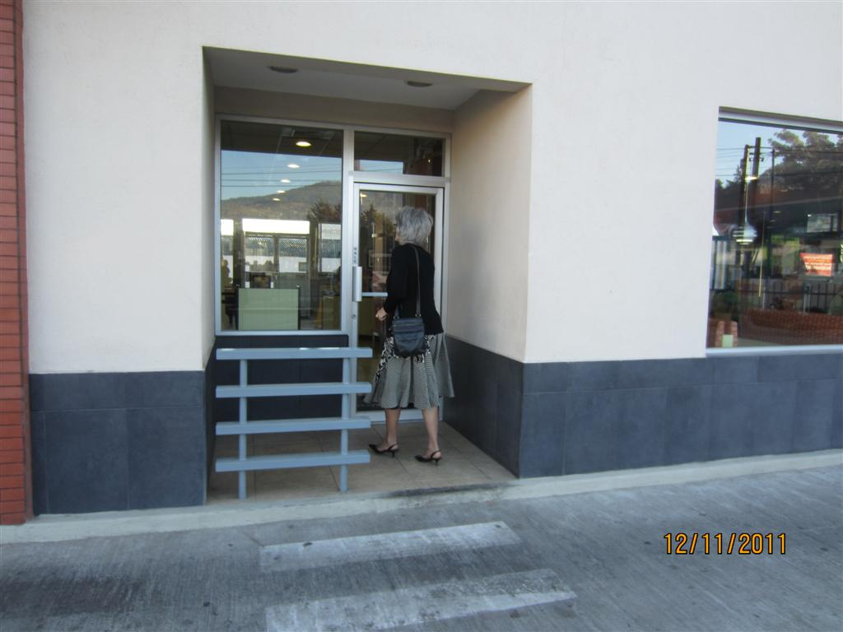

Slide 5
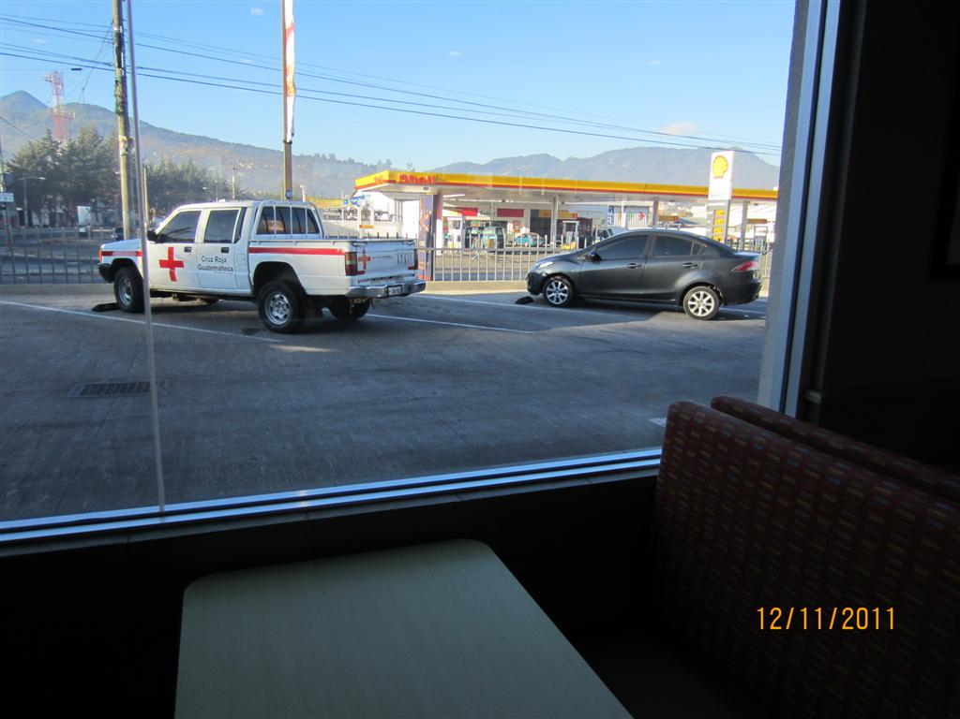

Slide 6
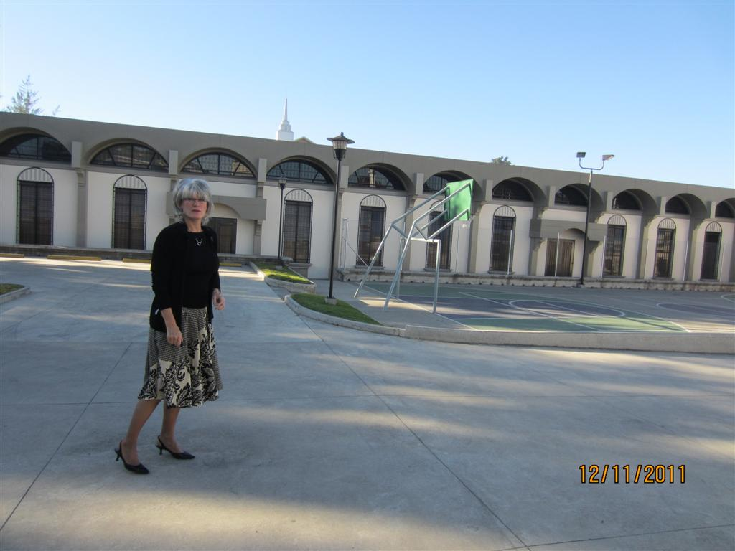

Slide 7
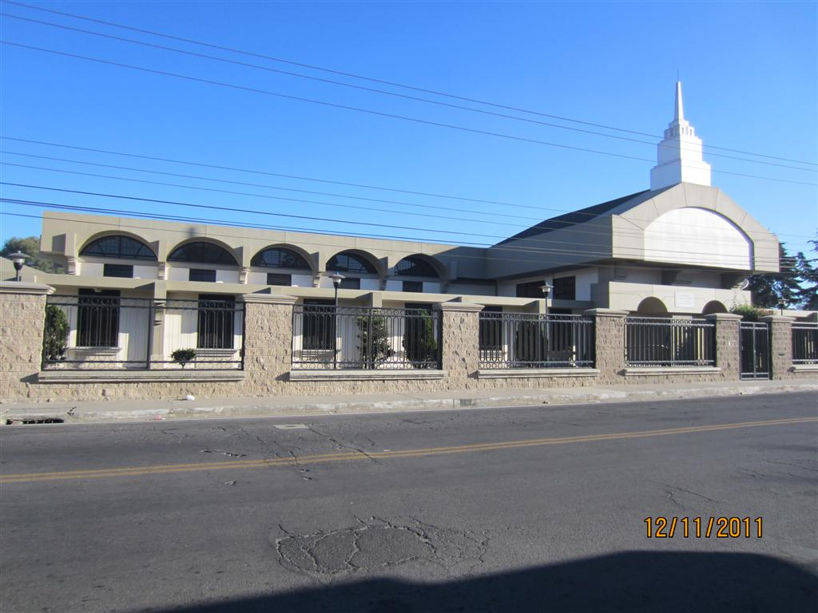

Slide 8
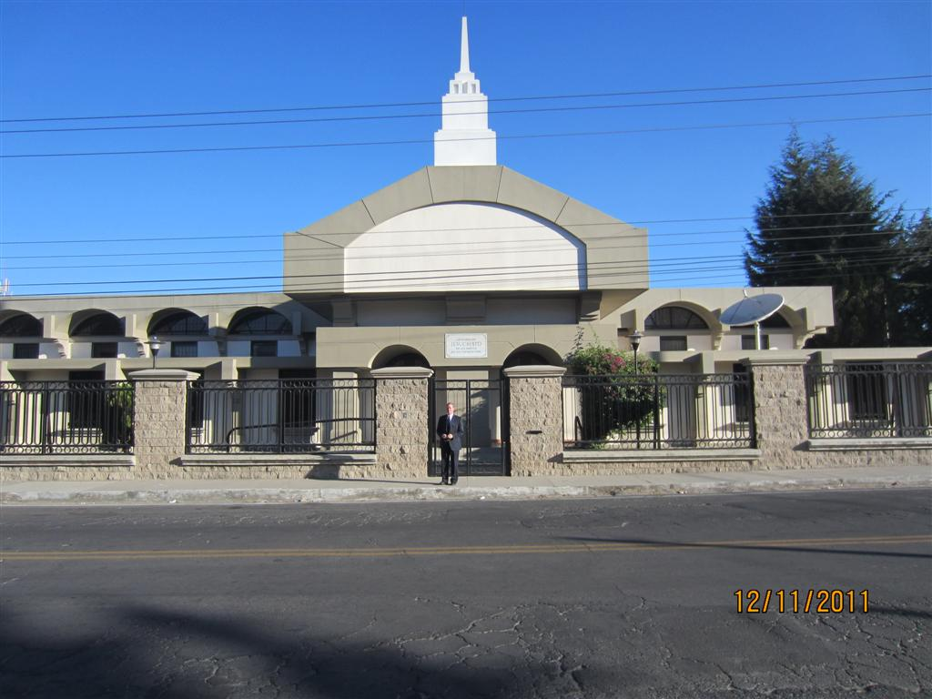

Slide 9
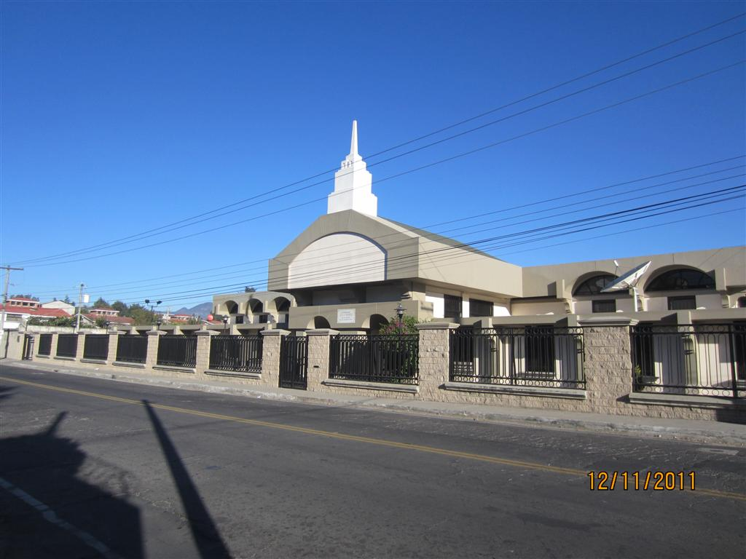

Slide 10
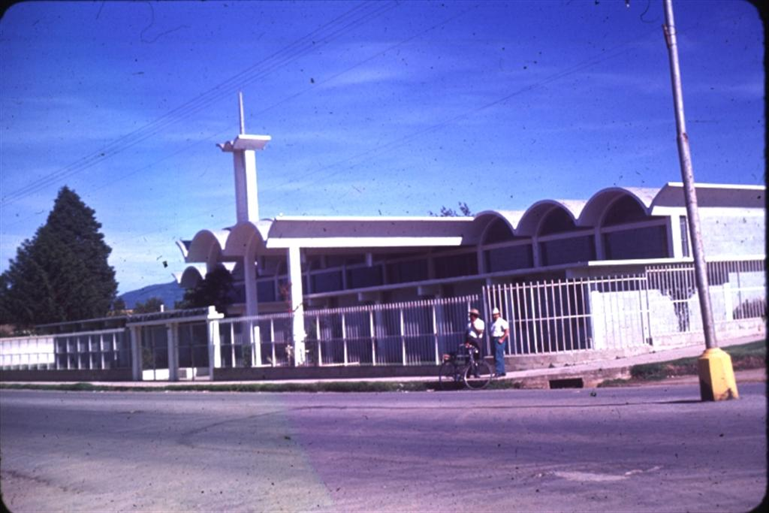

Slide 11
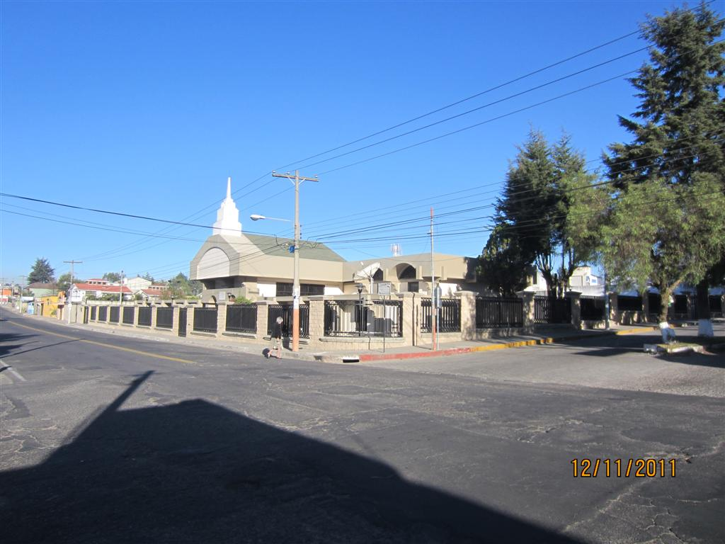

Slide 12
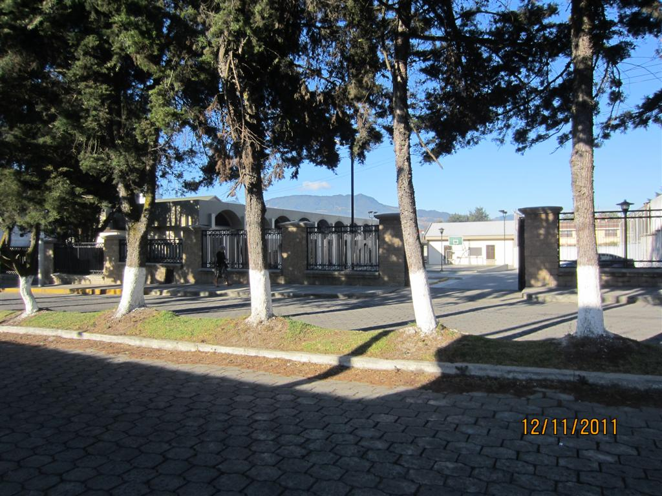

Slide 13
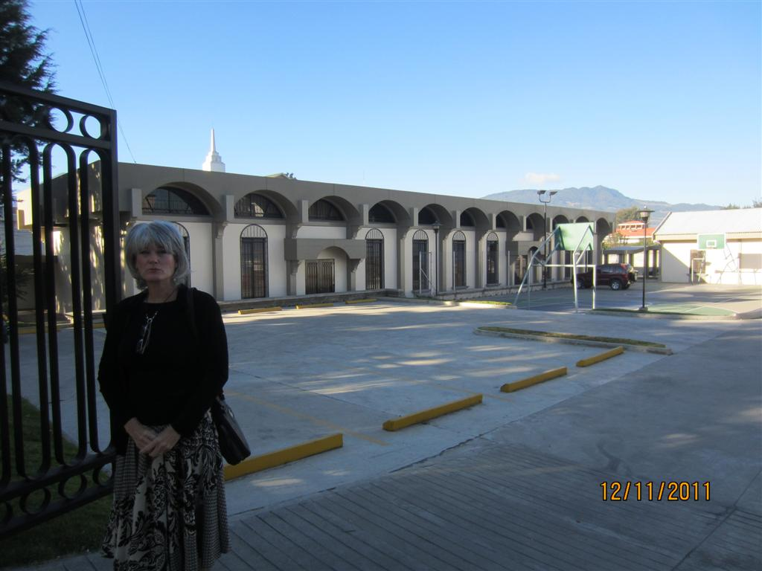

Slide 14
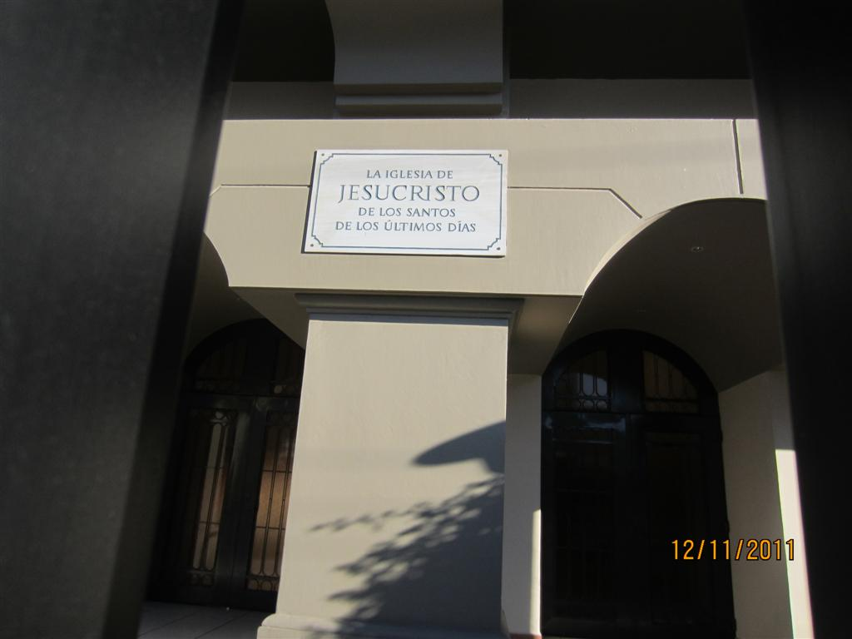

Slide 15
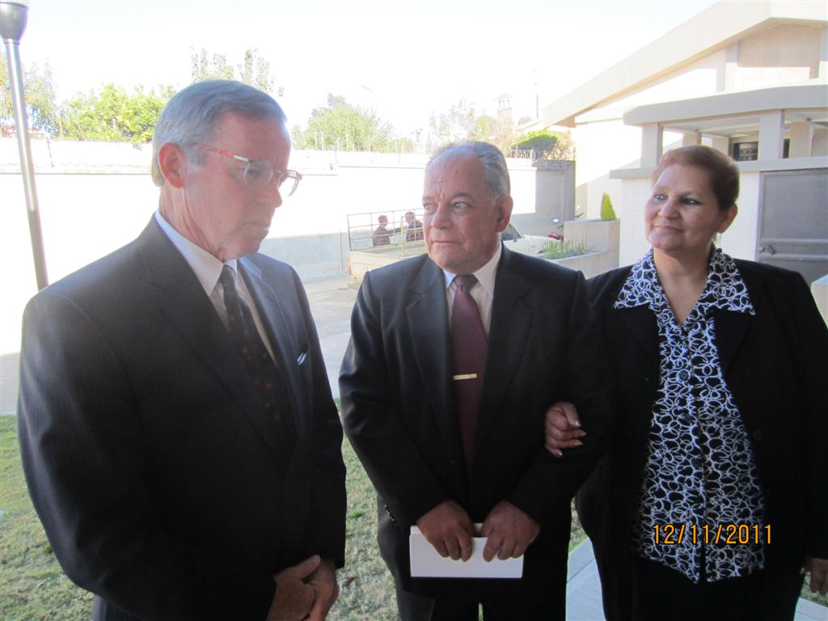

Slide 16
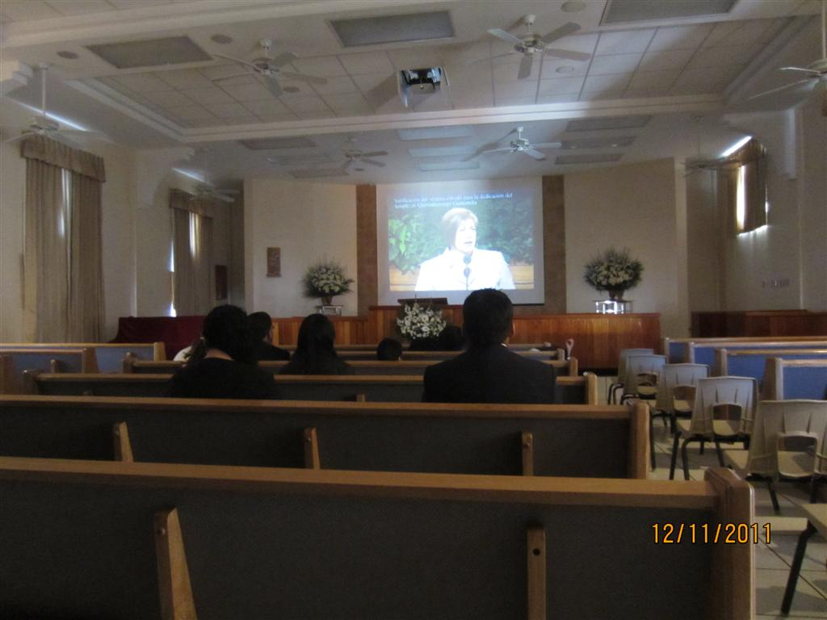

Slide 17
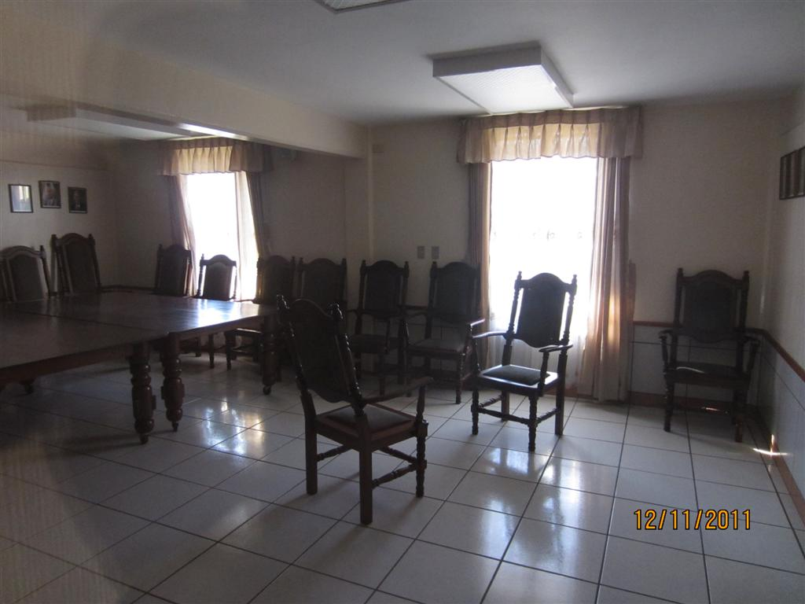

Slide 18
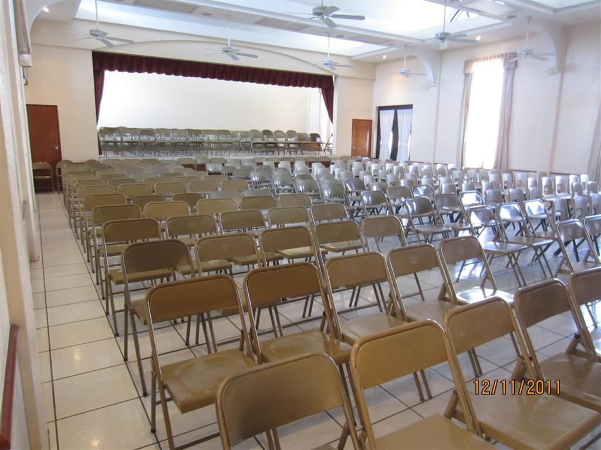

Slide 19
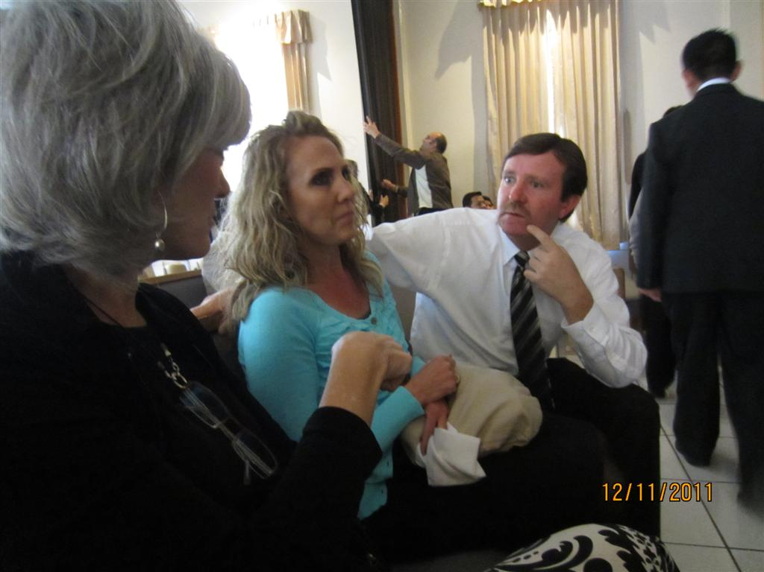

Slide 20
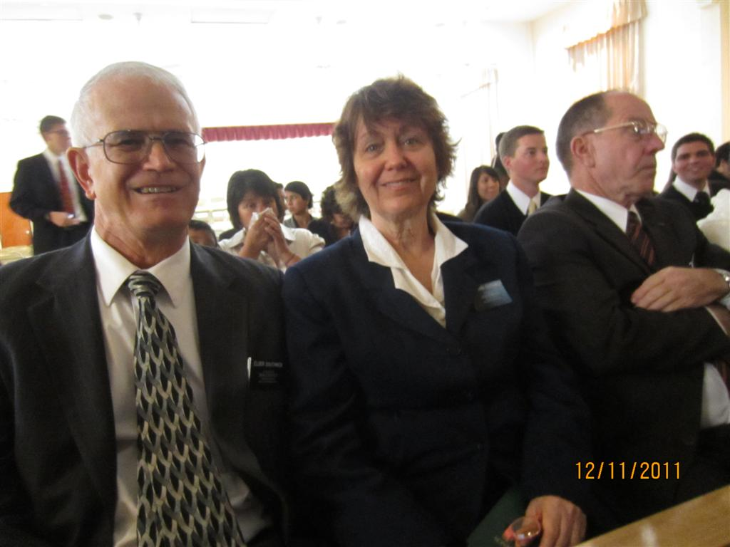

Slide 21
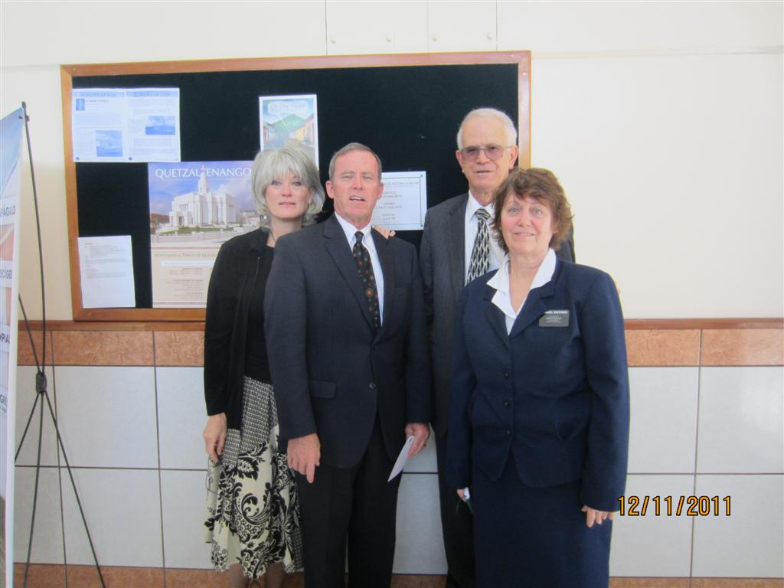

Slide 22
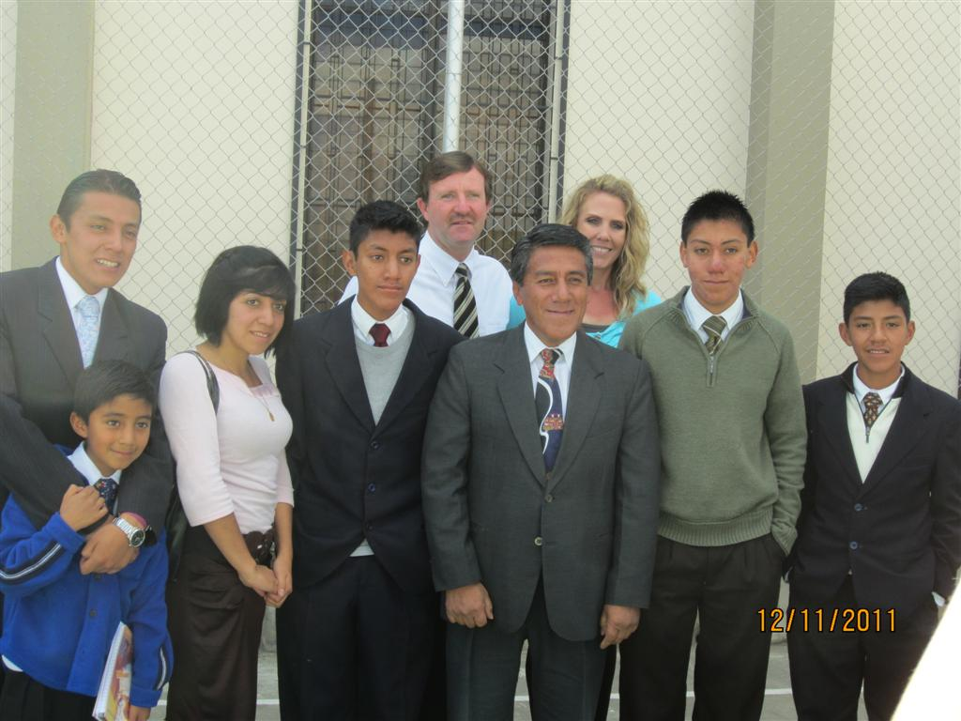

Slide 23
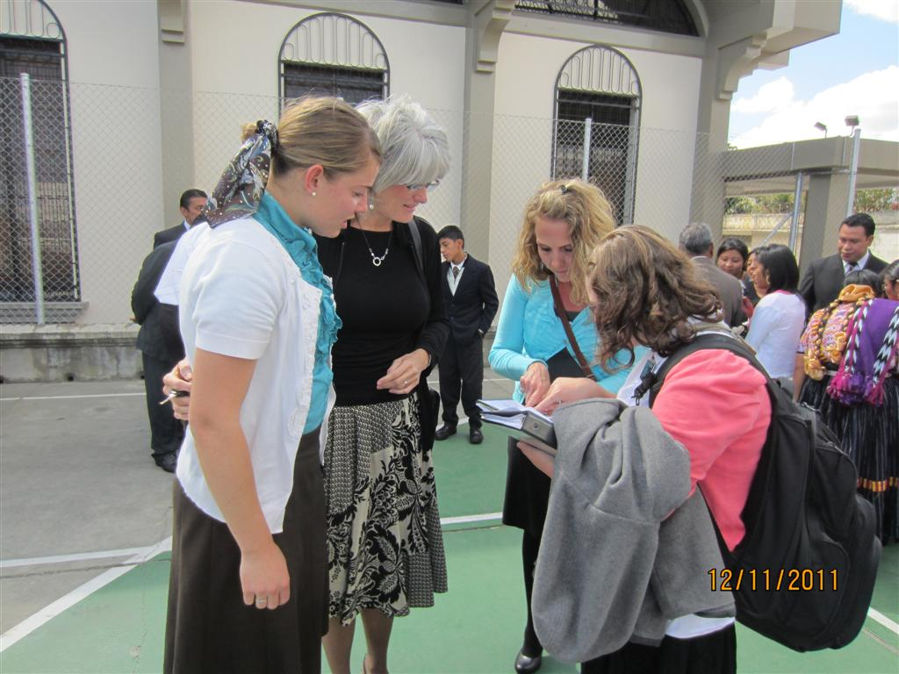

Slide 24
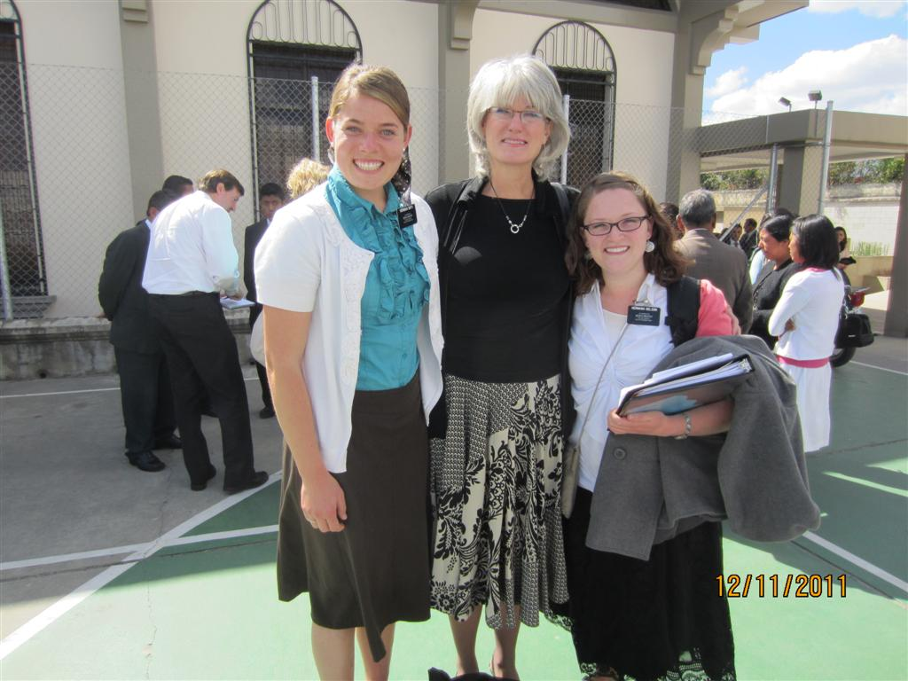

Slide 25
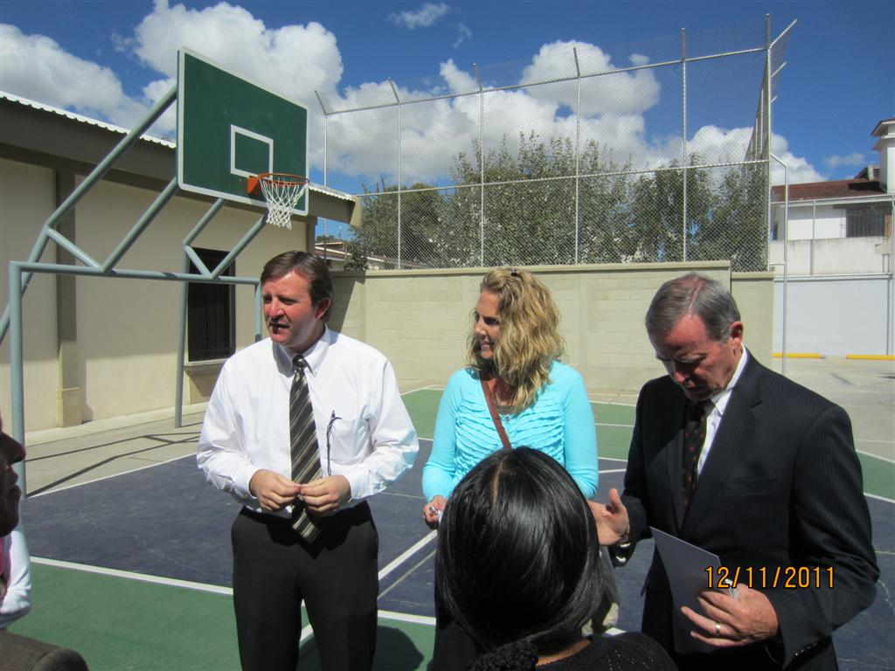

Slide 26
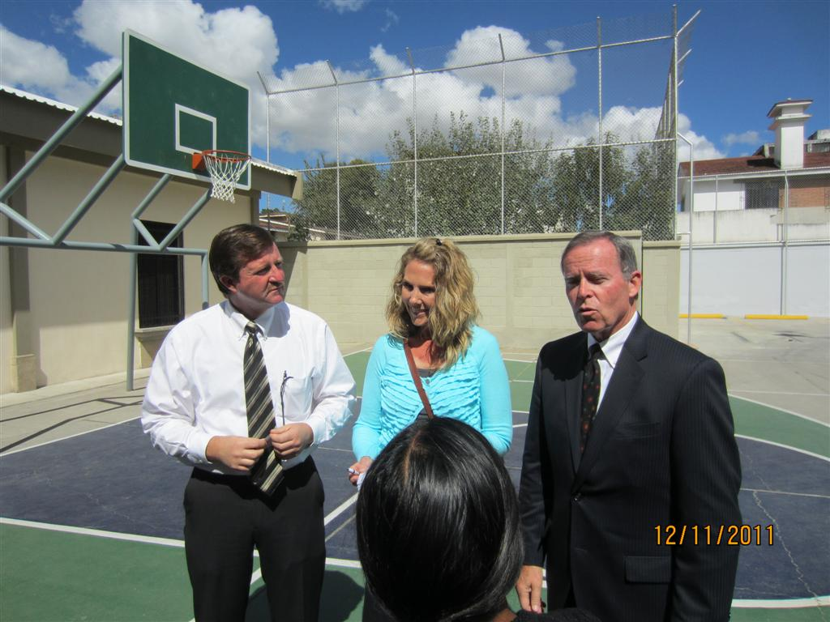

Slide 27
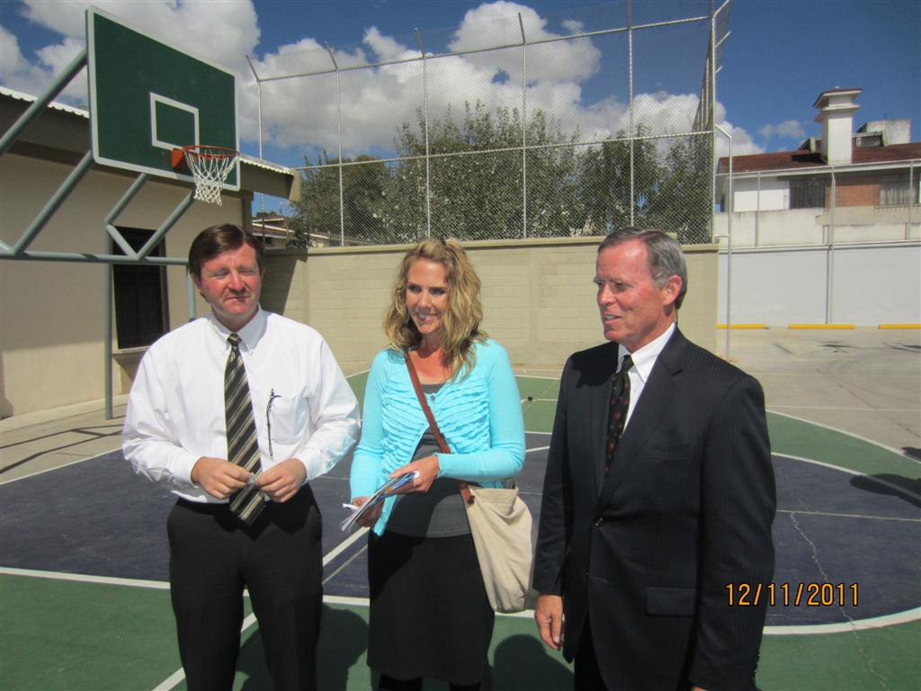

Slide 28
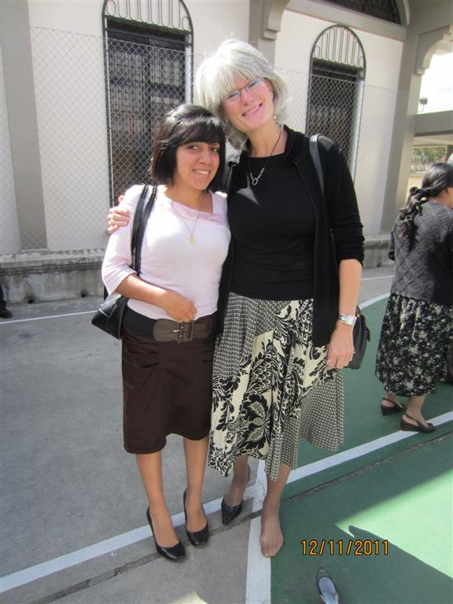

Slide 29
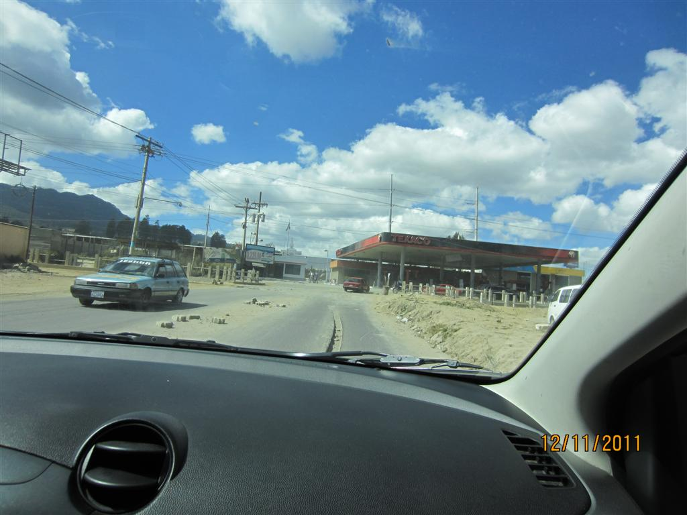

Slide 30
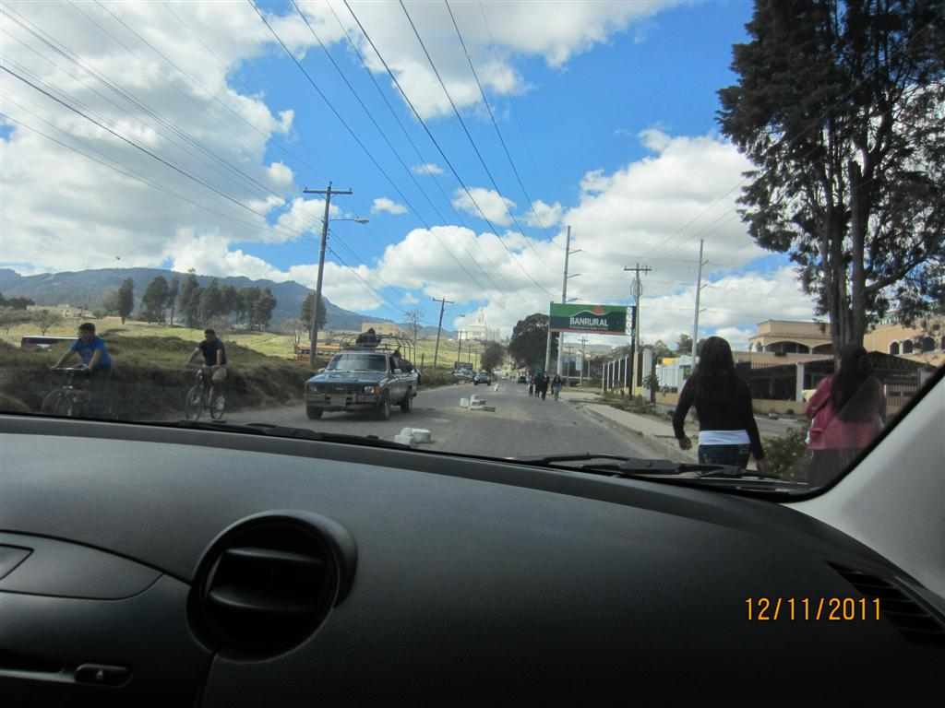

Slide 31
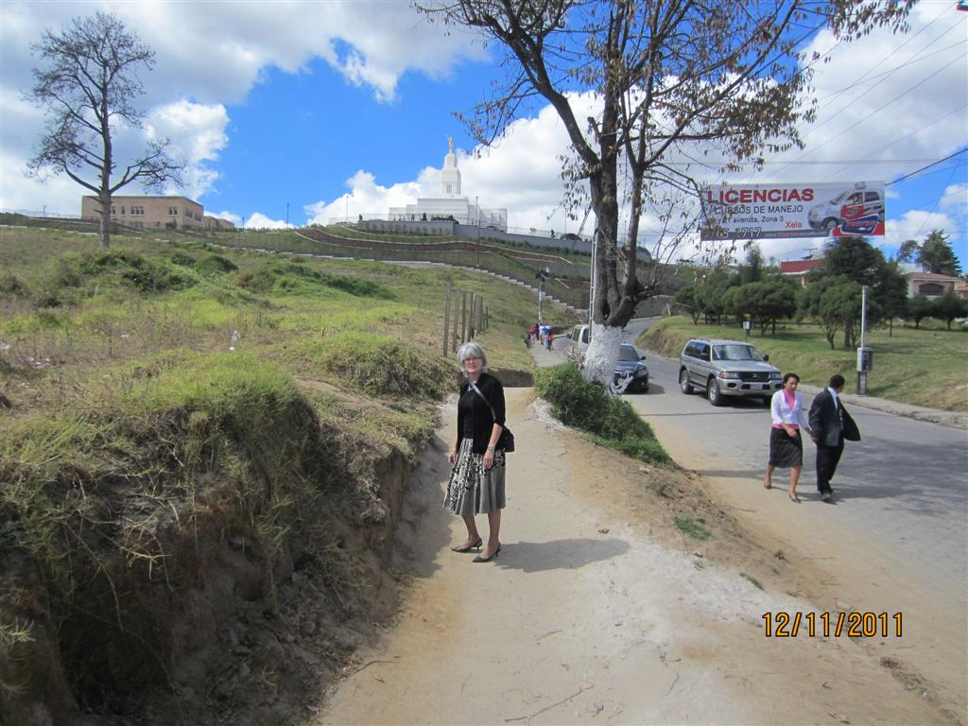

Slide 32
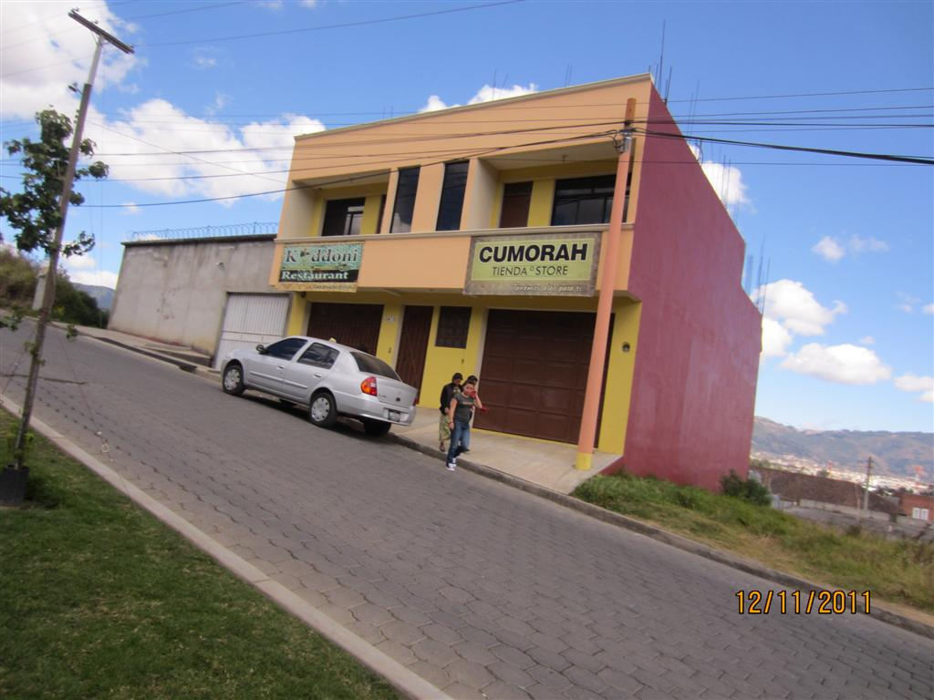

Slide 33
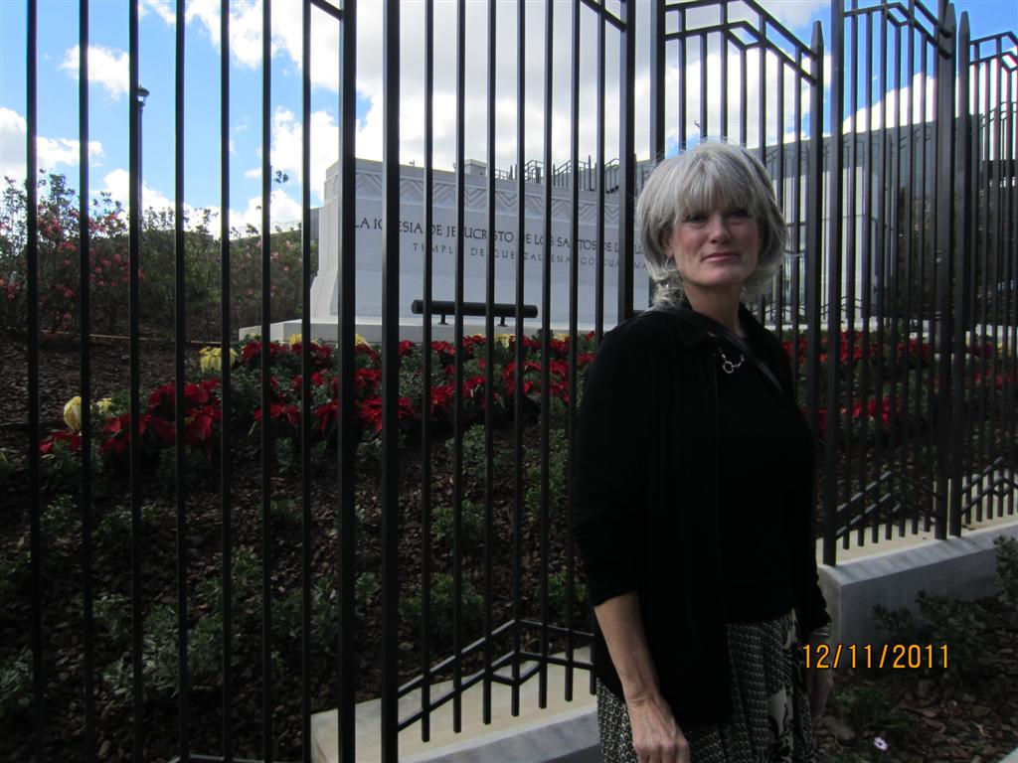

Slide 34
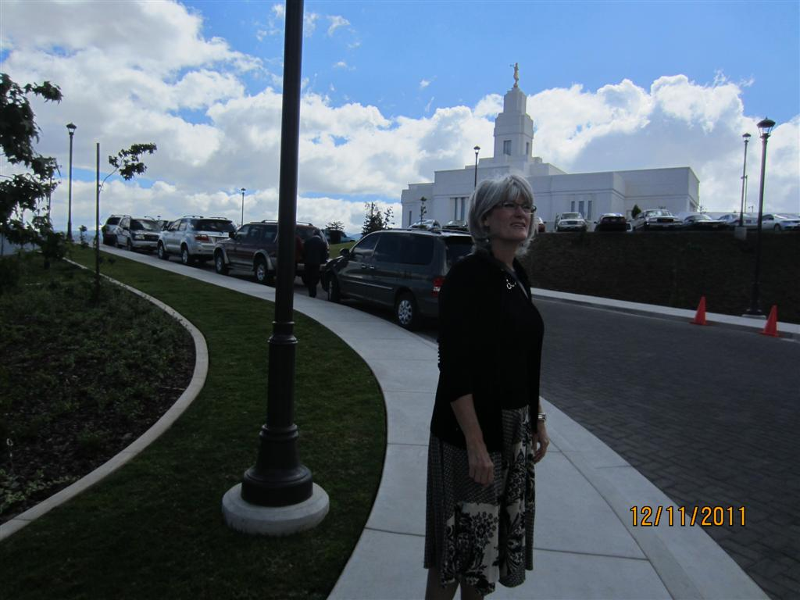

Slide 35
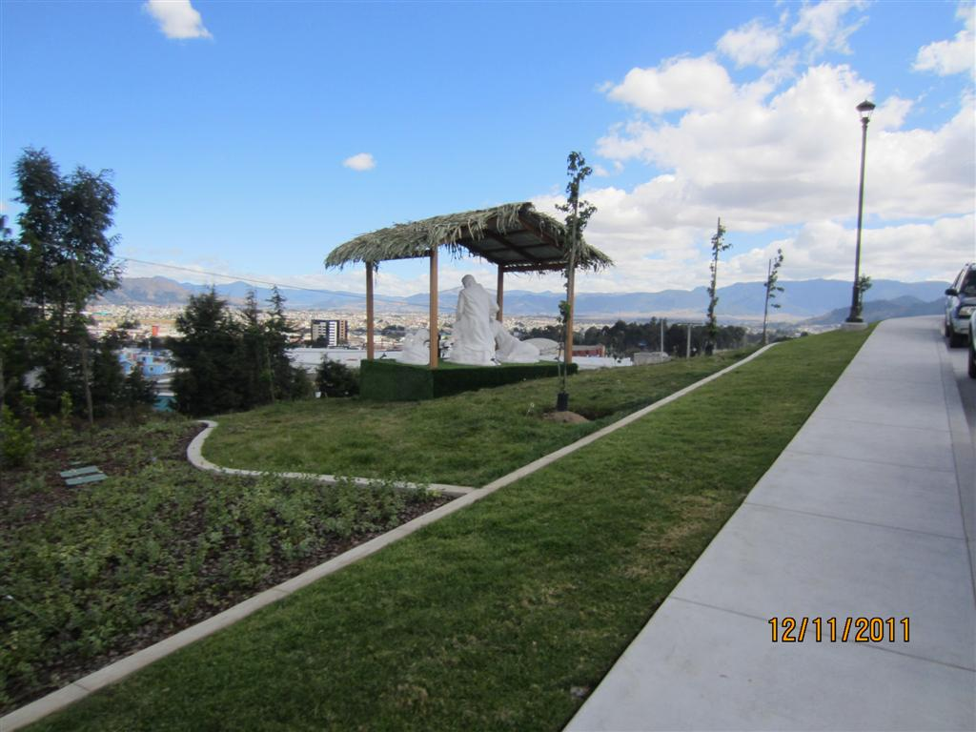

Slide 36
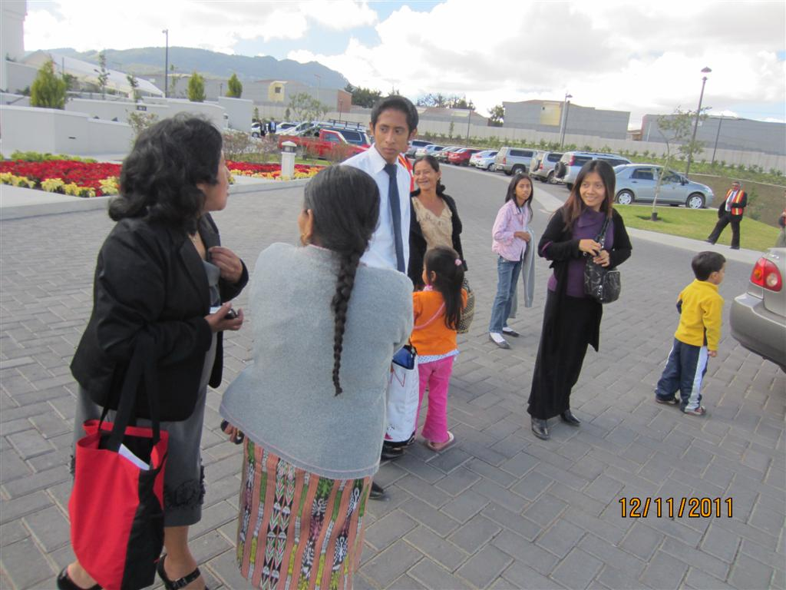

Slide 37
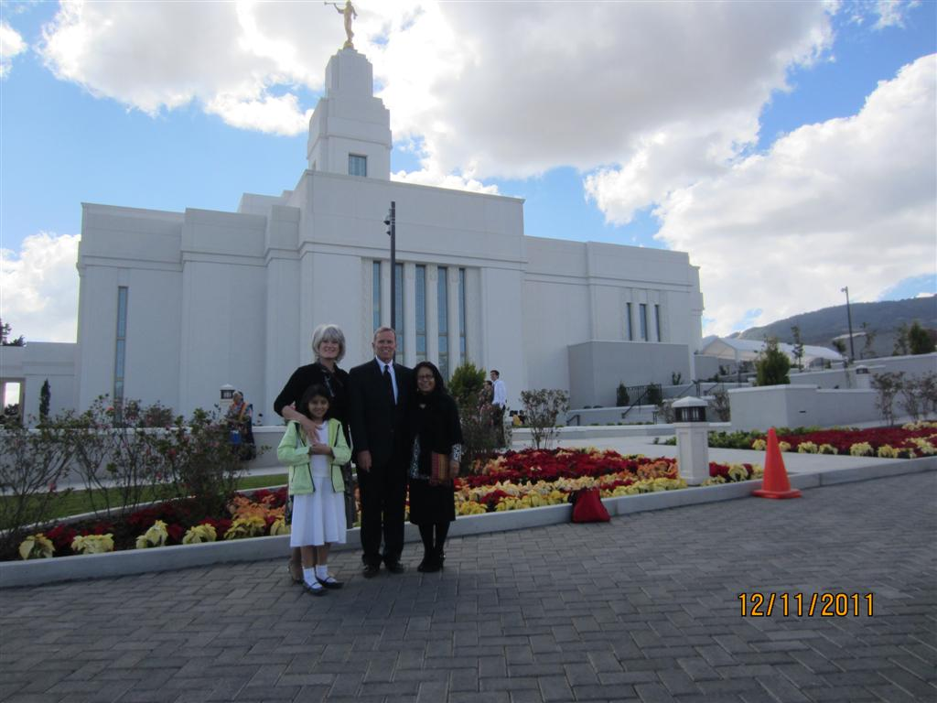

Slide 38
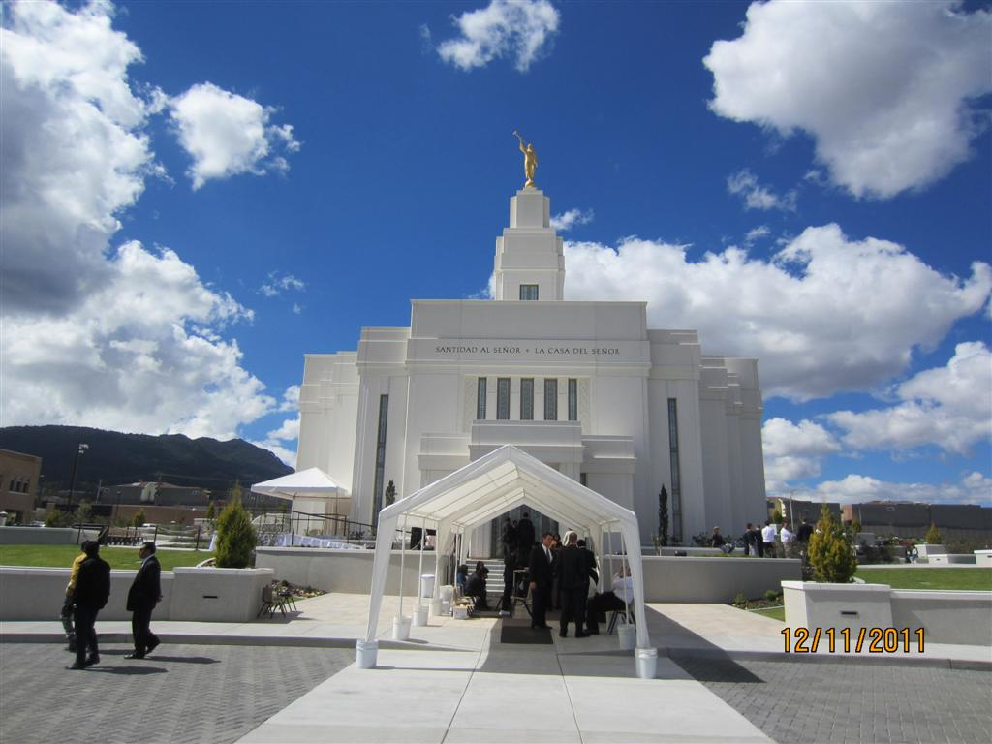

Slide 39
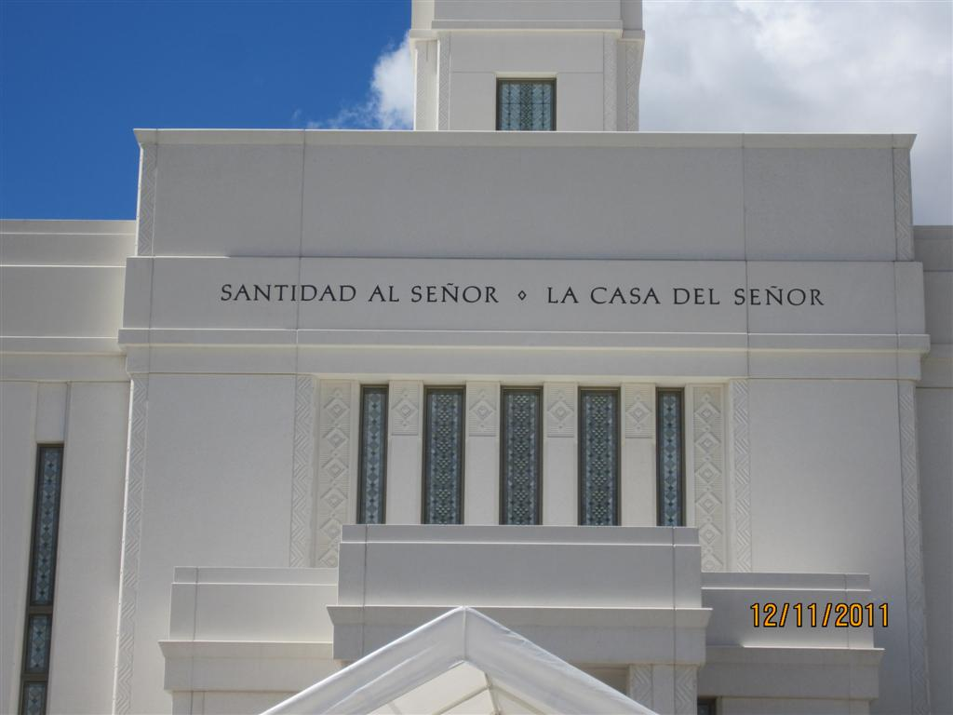

Slide 40
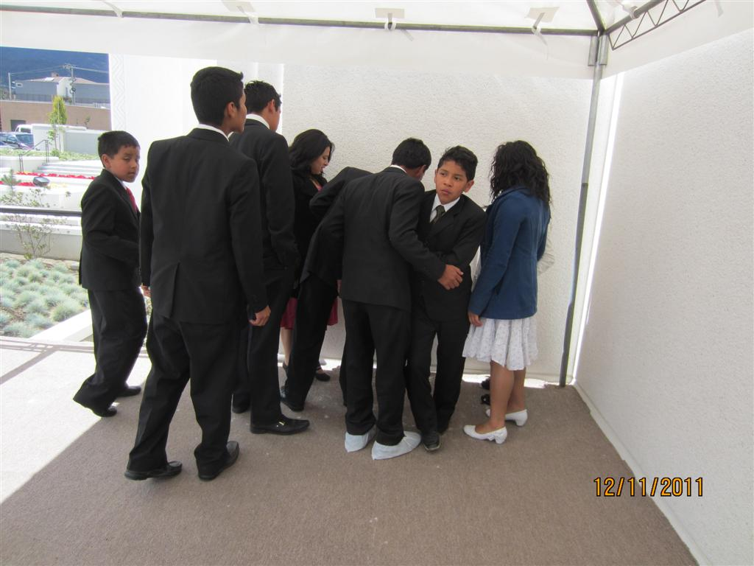

Slide 41
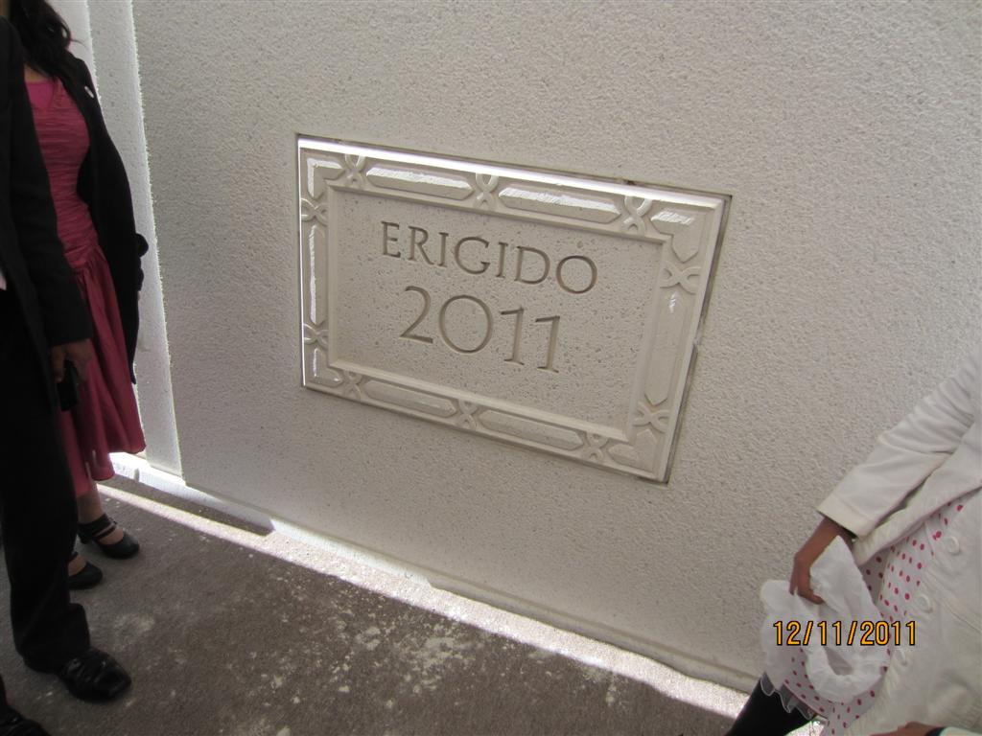

Slide 42
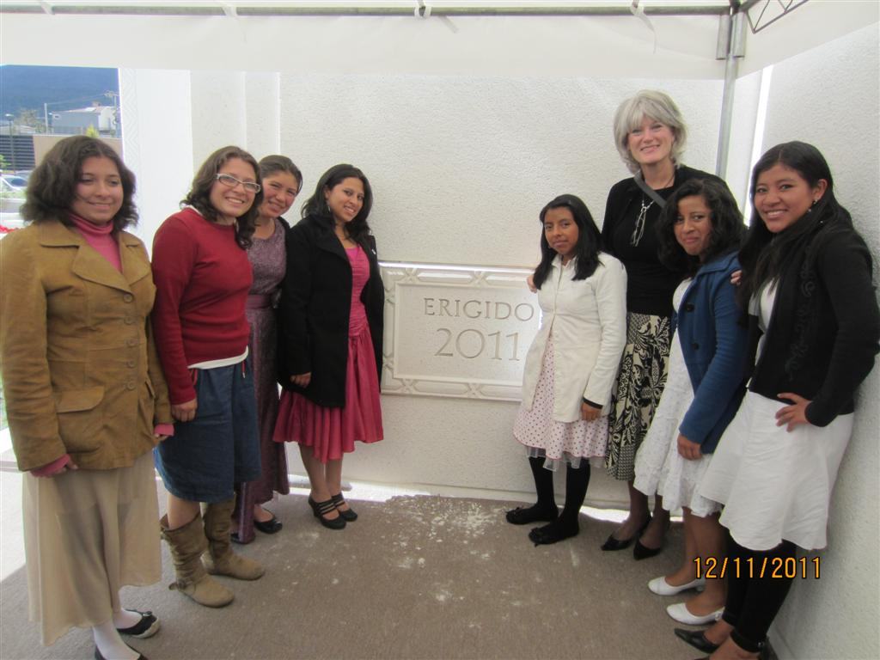

Slide 43
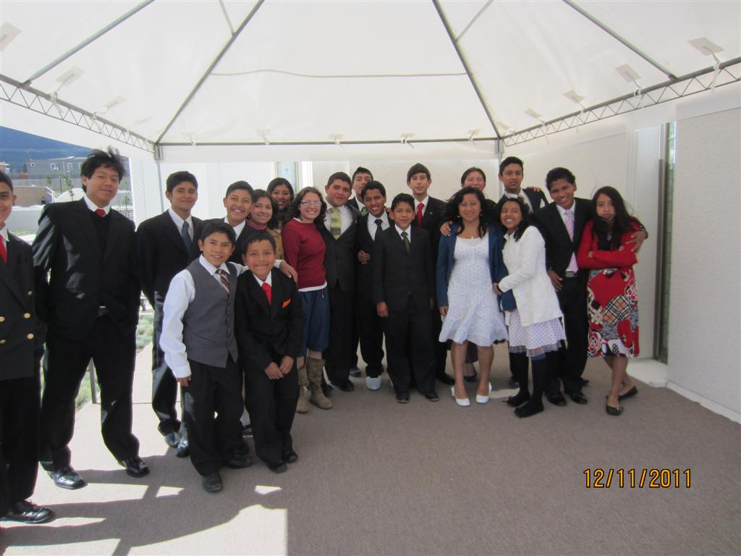

Slide 44
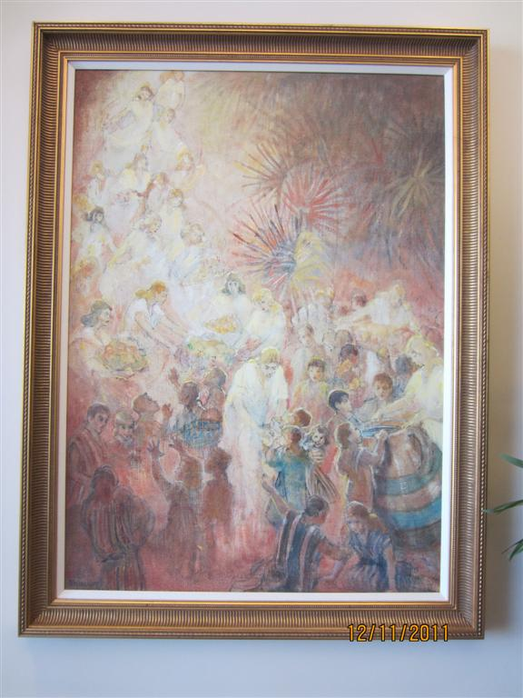

Slide 45
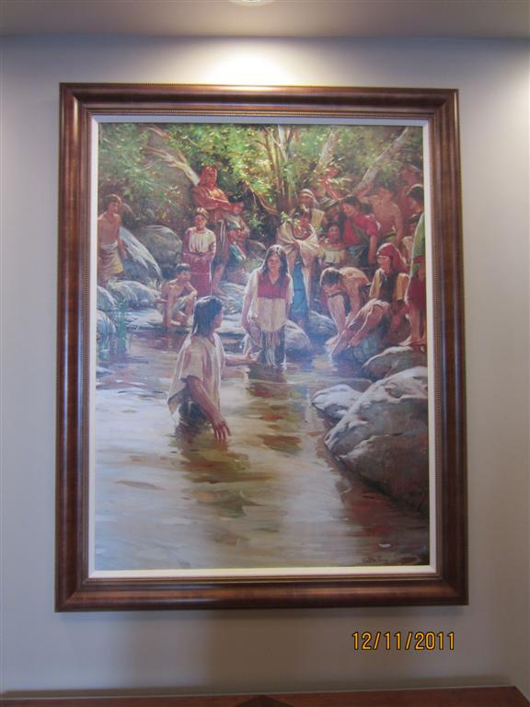

Slide 46
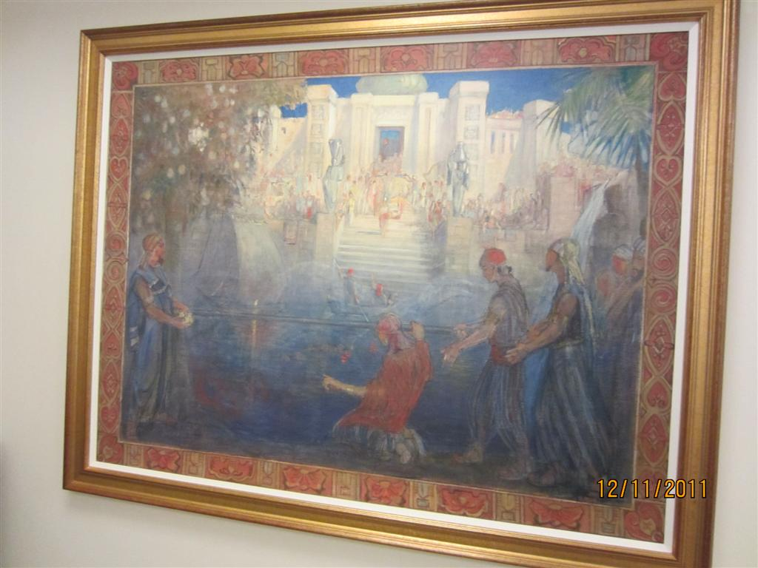

Slide 47
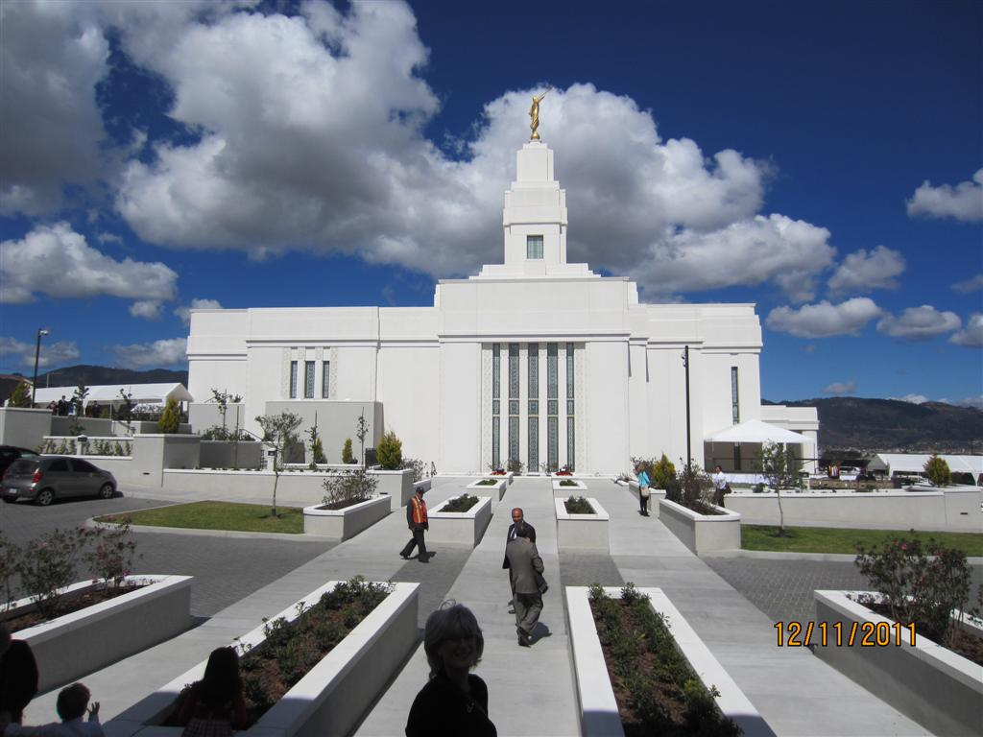

Slide 48
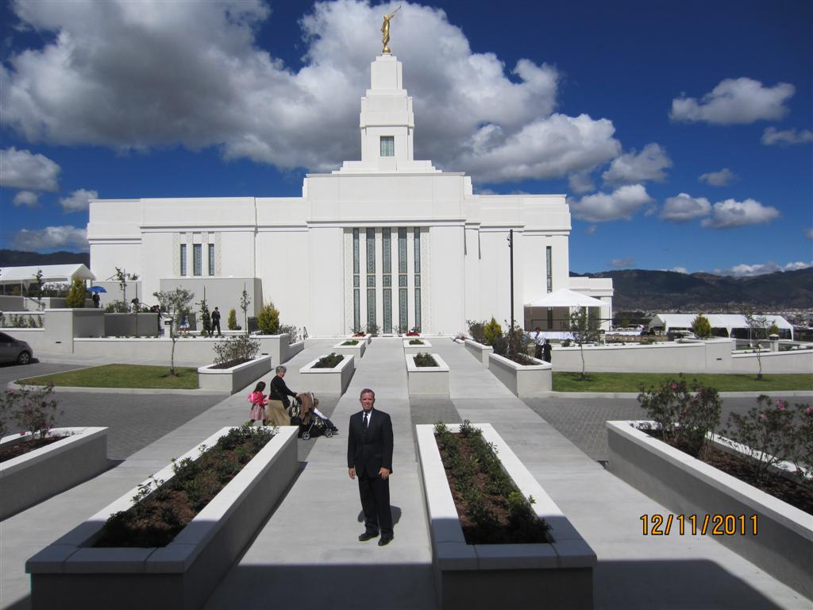

Slide 49
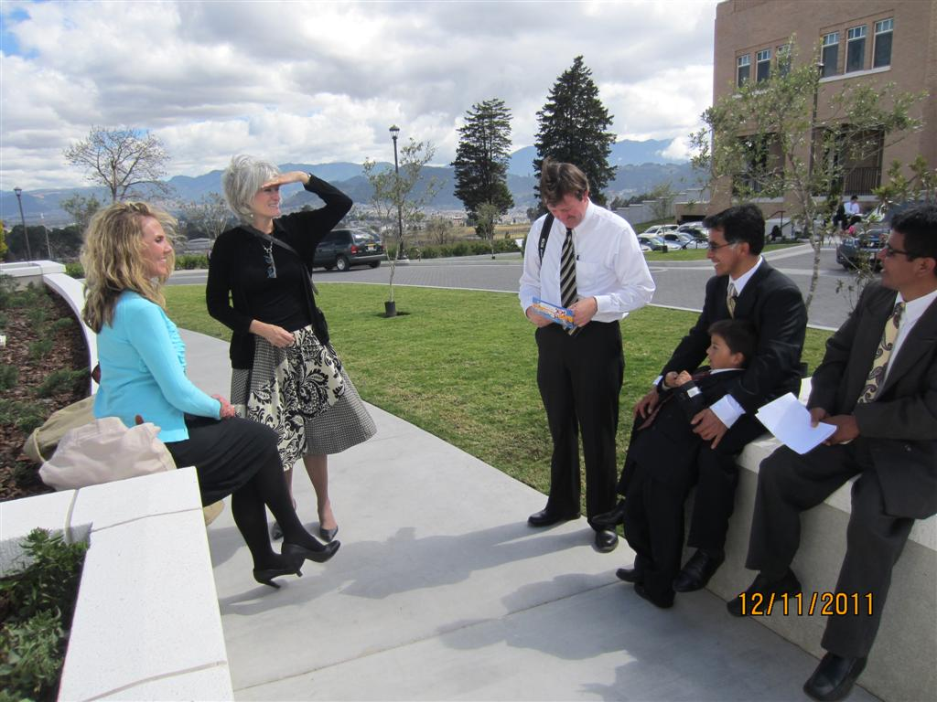

Slide 50
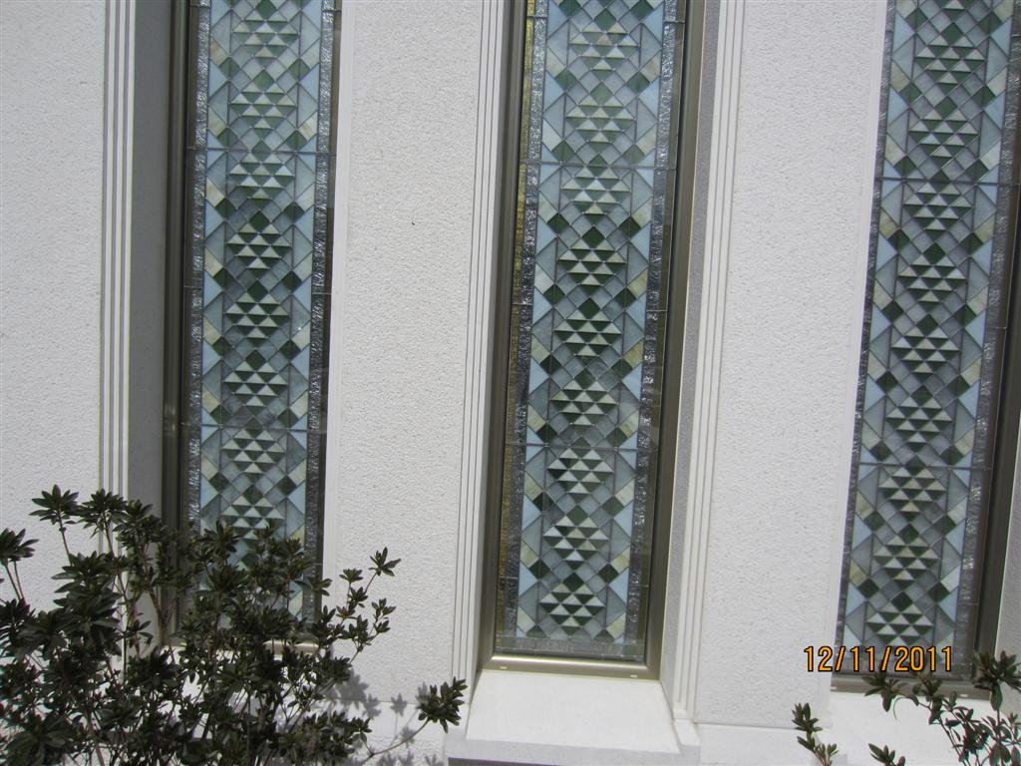

Slide 51
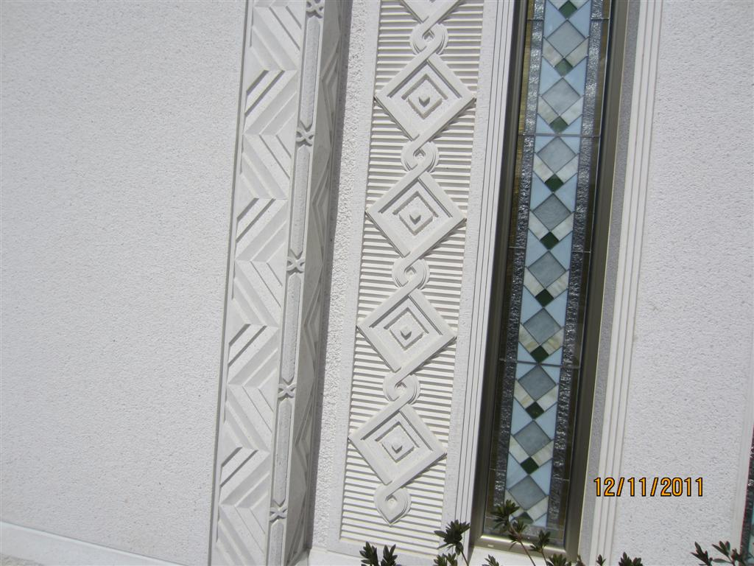

Slide 52
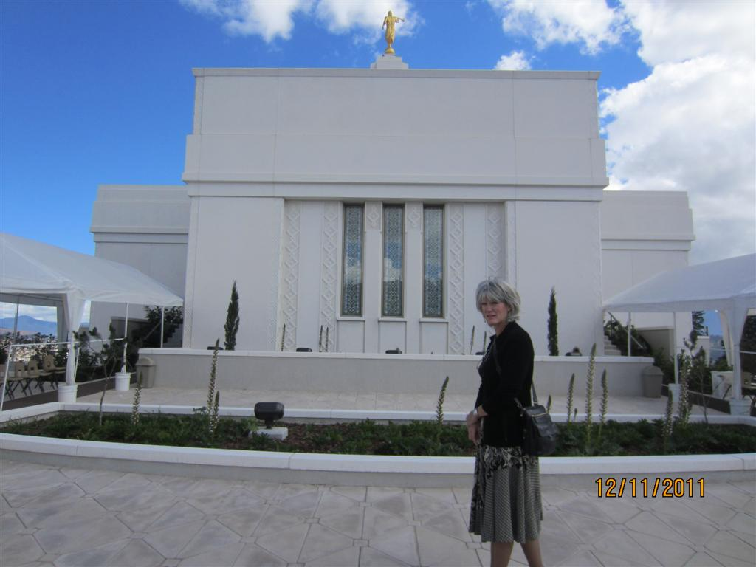

Slide 53
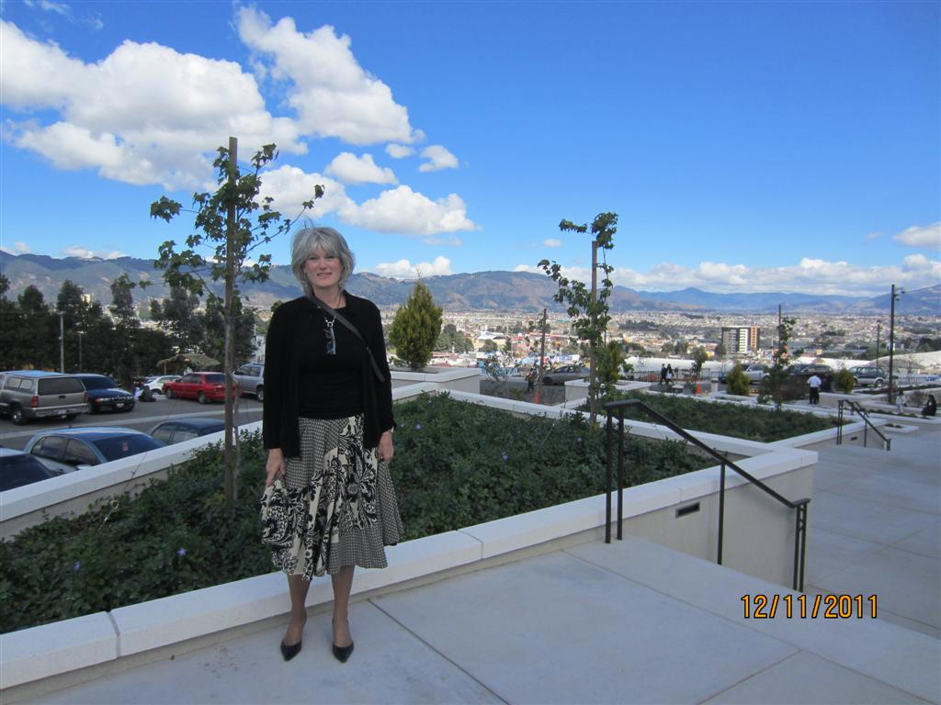

Slide 54


Slide 55


Slide 56


Slide 57


Slide 58


Slide 59


Slide 60


Slide 61


Slide 62


Slide 63


Slide 64


Slide 65


Slide 66


Slide 67


Slide 68


Slide 69


Slide 70


Slide 71


Slide 72


Slide 73


Slide 74


Slide 75


Slide 76


Slide 77


Slide 78


Slide 79


Slide 80


Slide 81


Slide 82


Slide 83


Slide 84


Slide 85


Slide 86


Slide 87


Slide 88


Slide 89


Slide 90


Slide 91


Slide 92


Slide 93


Slide 94


Slide 95


Slide 96


Slide 97


Slide 98


Slide 99


Slide 100


Slide 101


Slide 102


Slide 103


Slide 104


Slide 105


Slide 106


Slide 107


Slide 108


Slide 109


Slide 110


Slide 111


Slide 112


Slide 113


Slide 114


Slide 115


Slide 116


Slide 117


Slide 118


Slide 119


Slide 120


