Slide 1
Day 8 - Thursday
December 8, 2011

Slide 2
4am – up
5am-at TAG for flight to Flores.
Drive to Tikal about 70 minutes or so. Carlos guide (400 Q-about $50)(transportation also 400 Q)
Tikal/agouti/howler monkeys/woodpecker/toucan/coatamundi/lots of ruins
1:30 lunch and Comedor Tikal/Frijoles negros y arroz y tortillas.
5:15 flight to Guatemala City.
6:15 home.

Slide 3
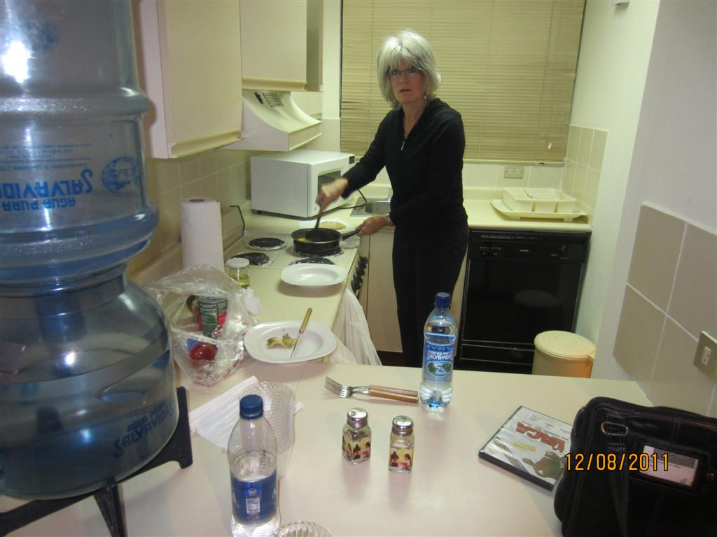

Slide 4
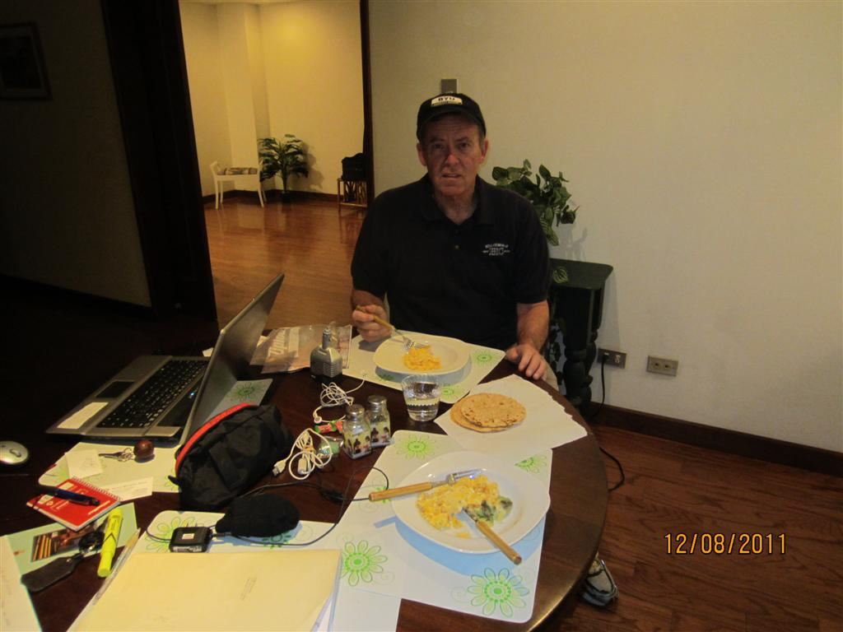

Slide 5
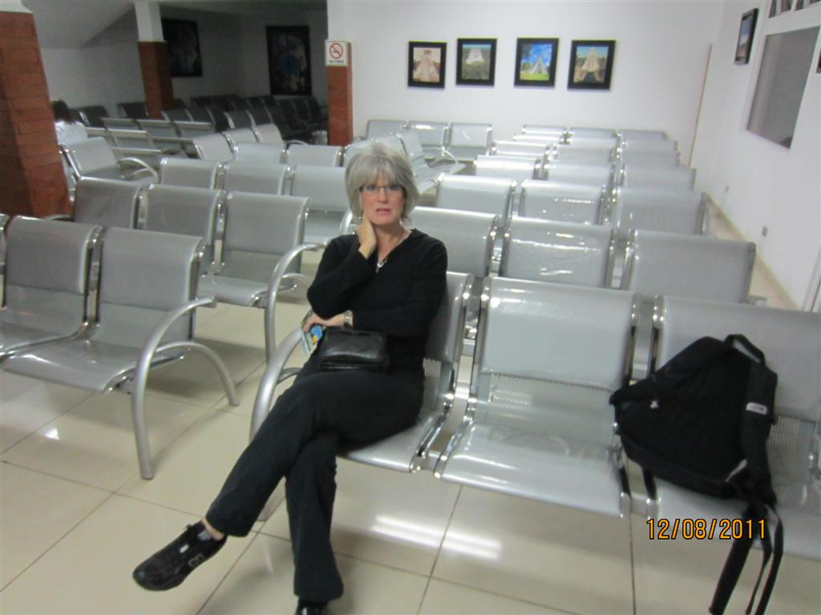

Slide 6
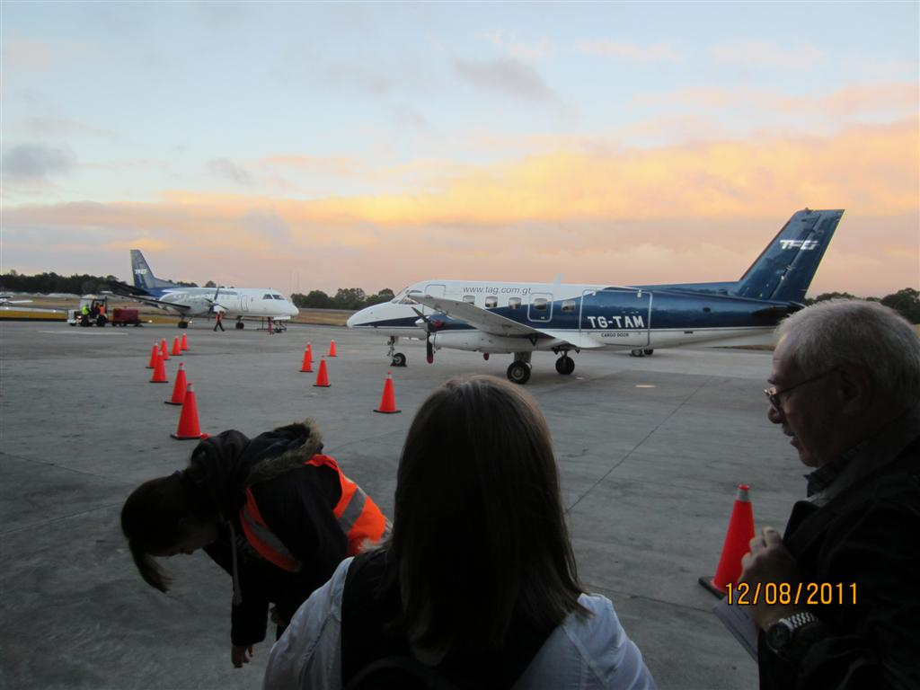

Slide 7
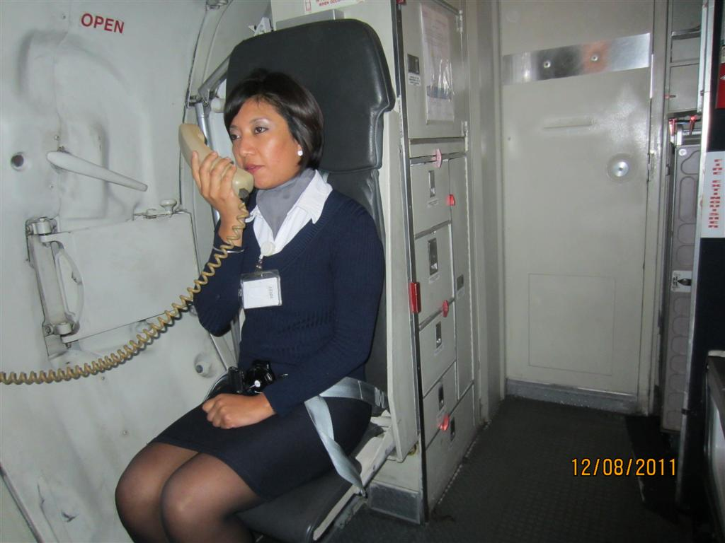

Slide 8
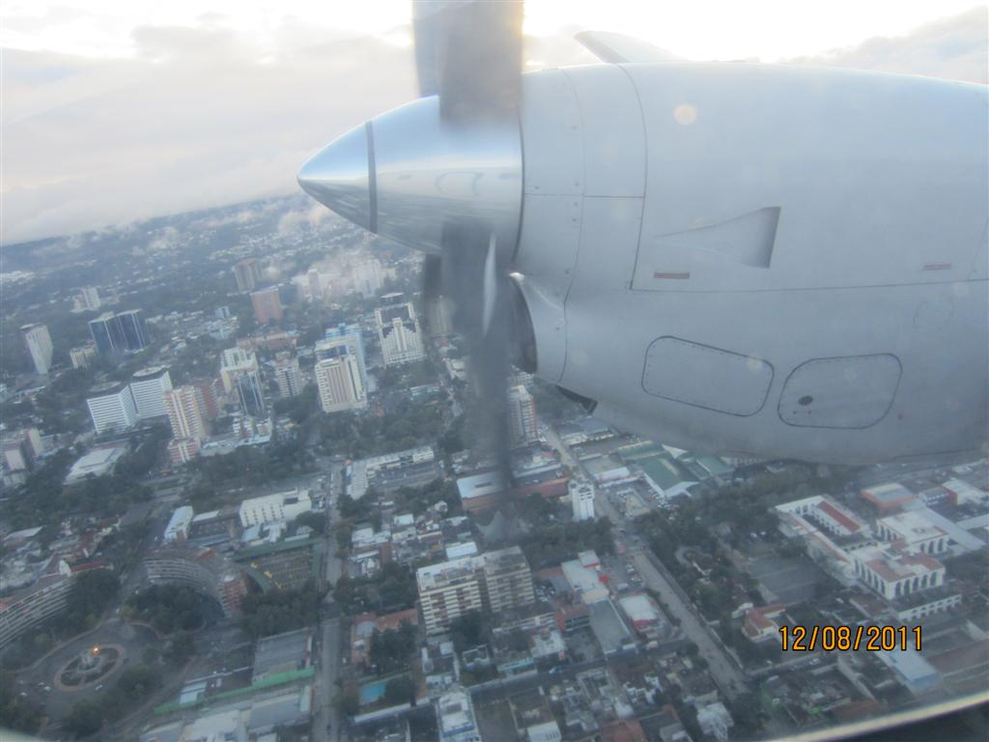

Slide 9
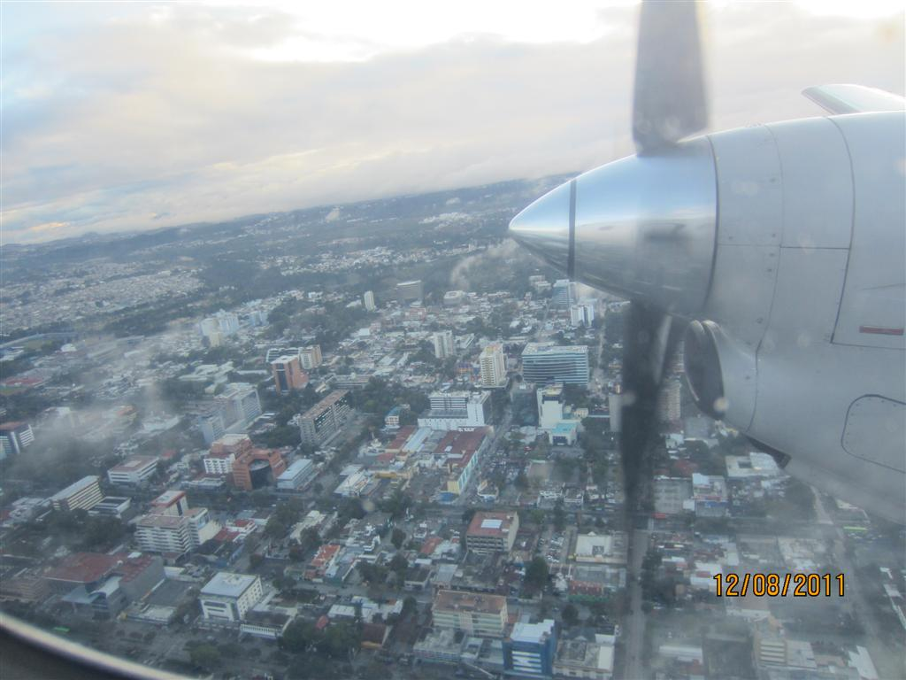

Slide 10
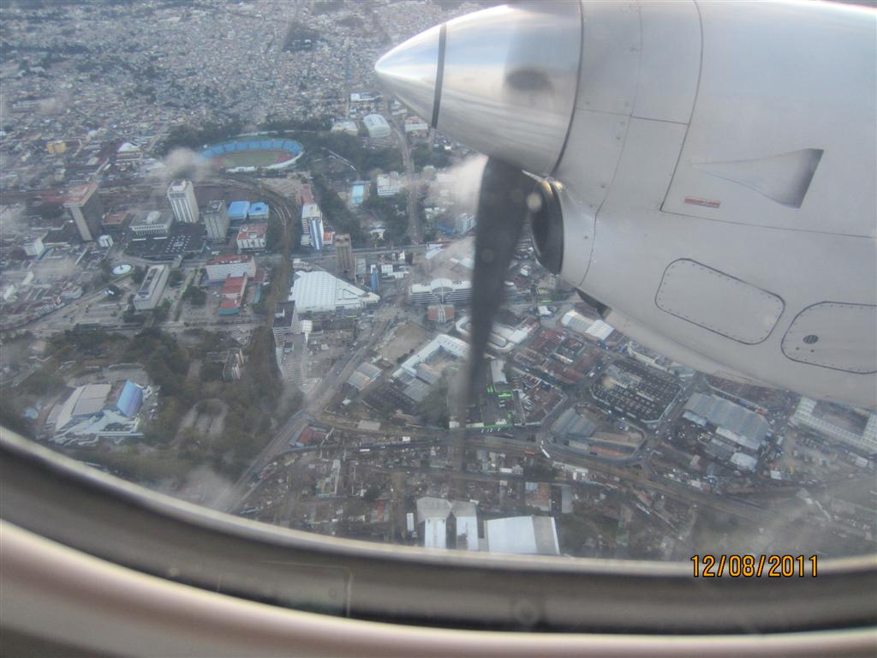

Slide 11
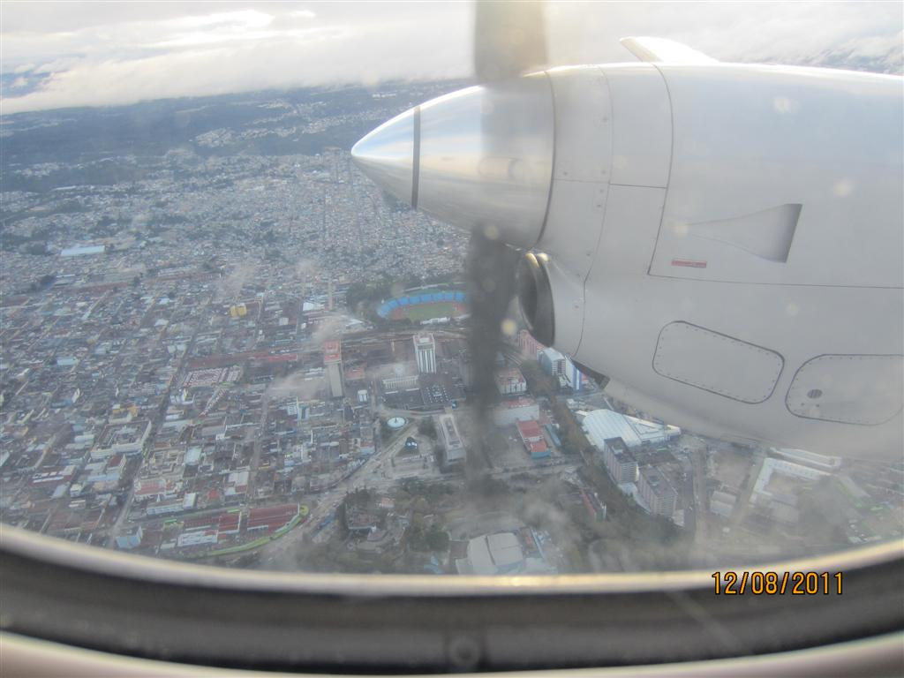

Slide 12
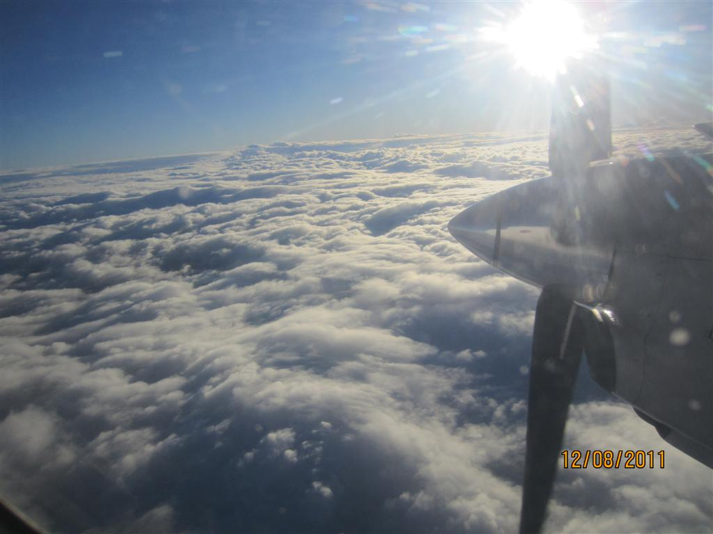

Slide 13
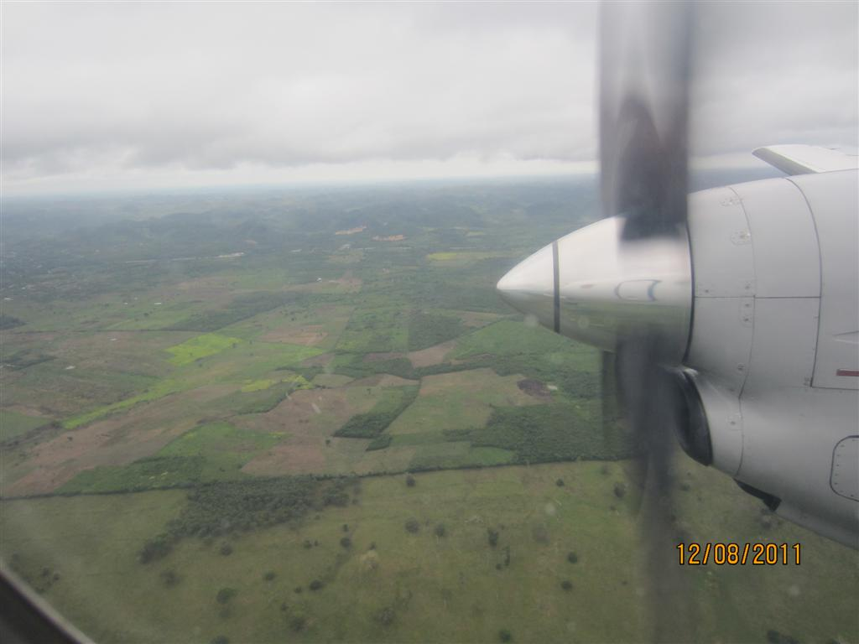

Slide 14
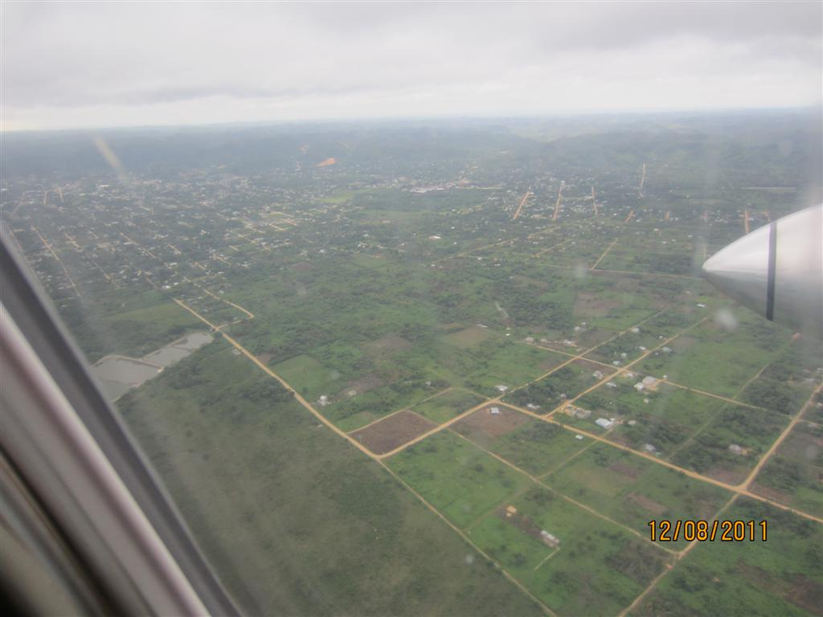

Slide 15
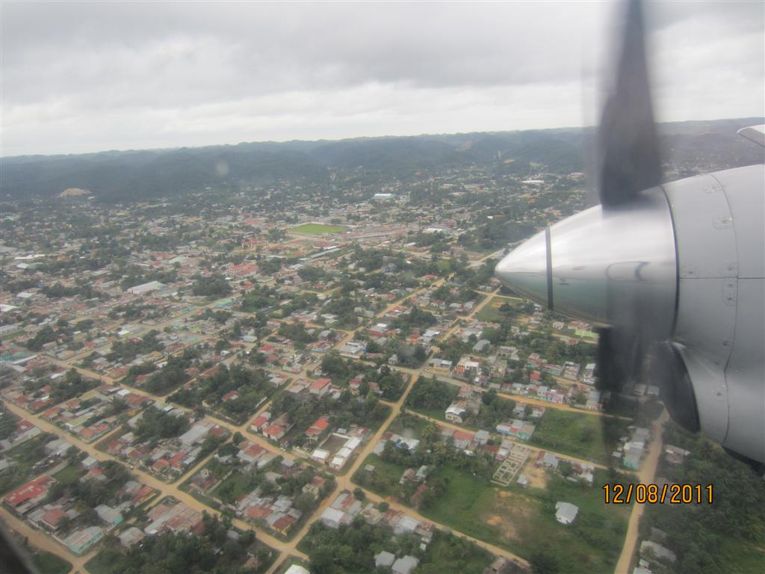

Slide 16
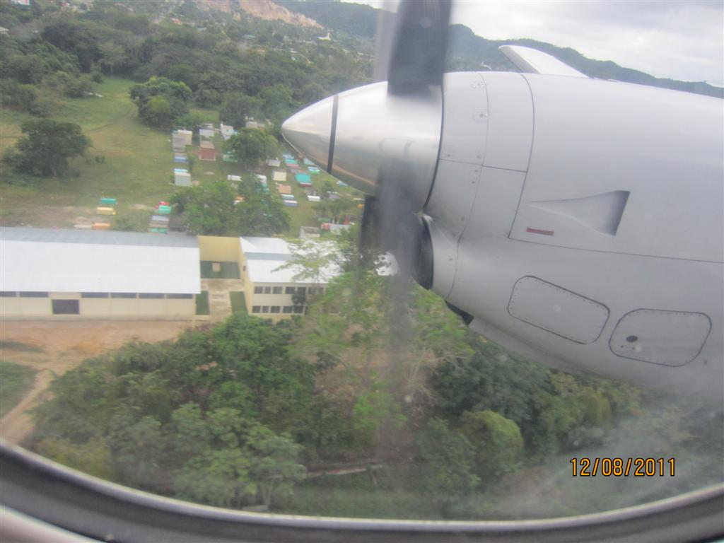

Slide 17
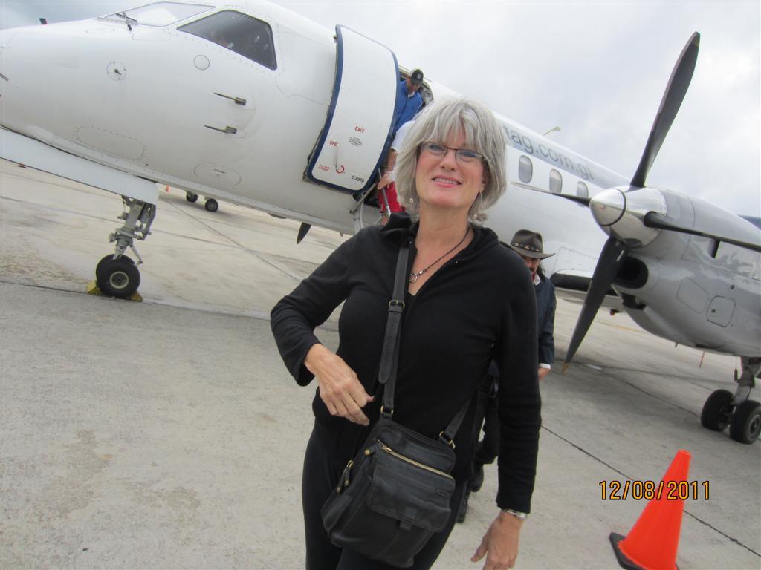

Slide 18
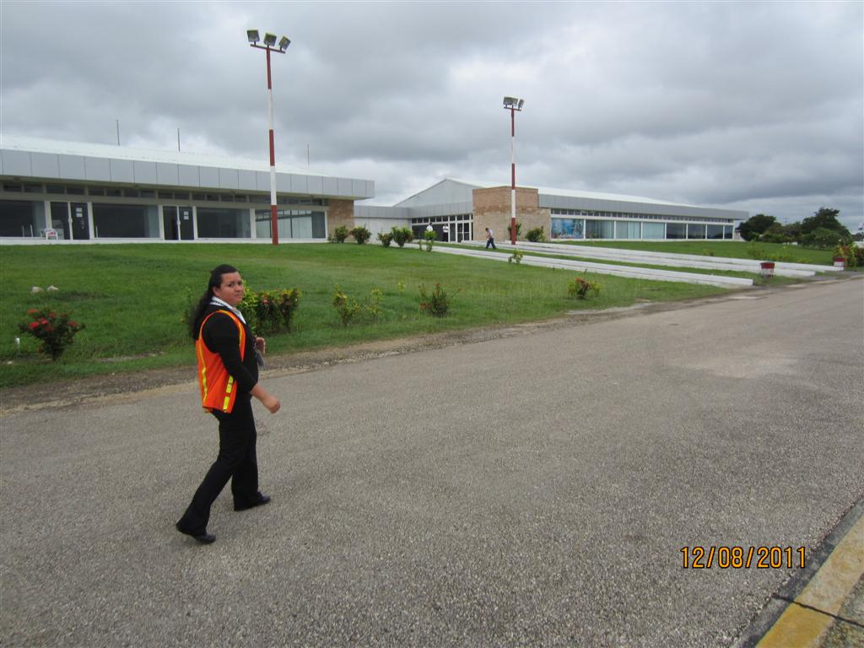

Slide 19
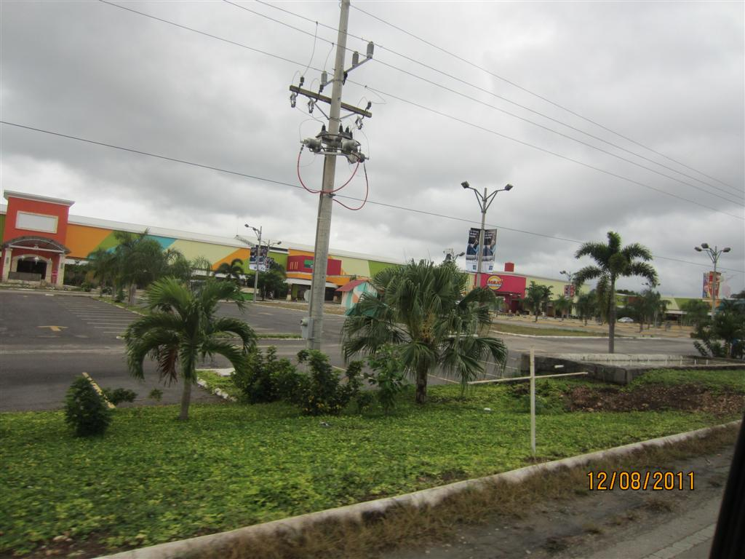

Slide 20
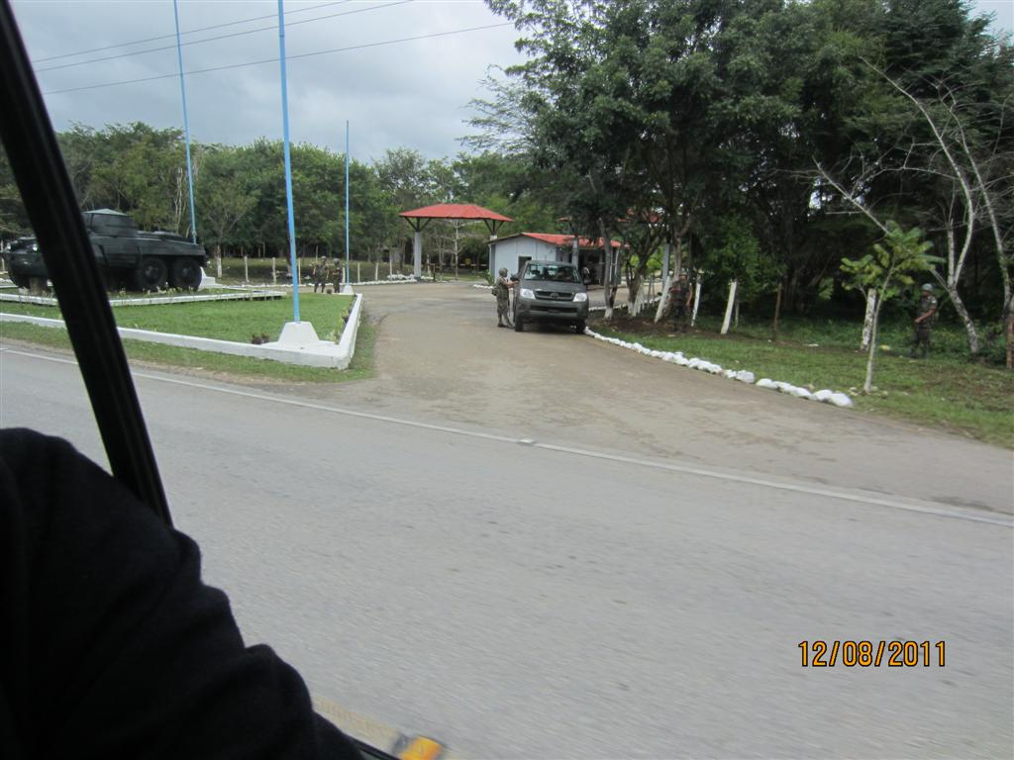

Slide 21
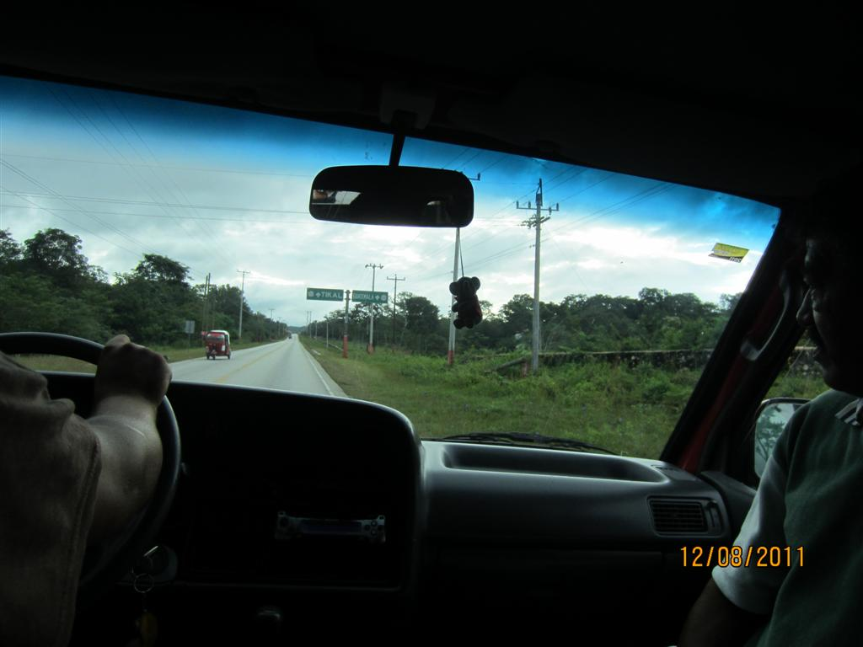

Slide 22
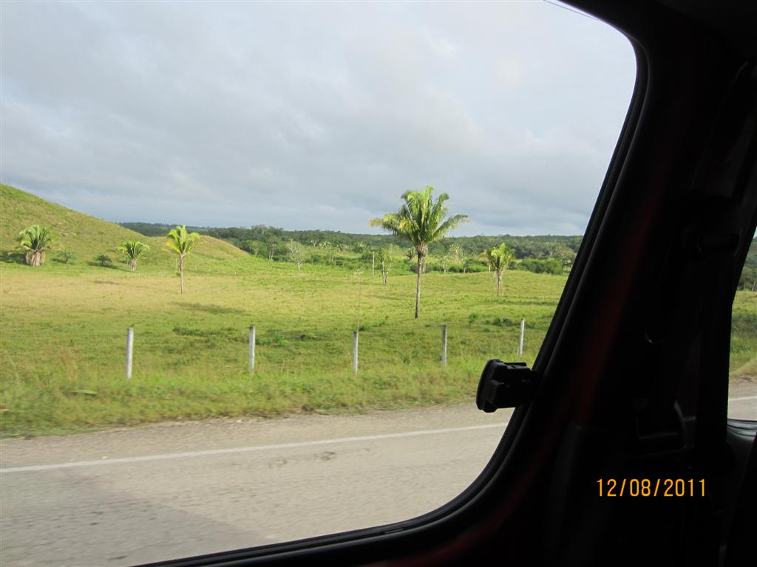

Slide 23
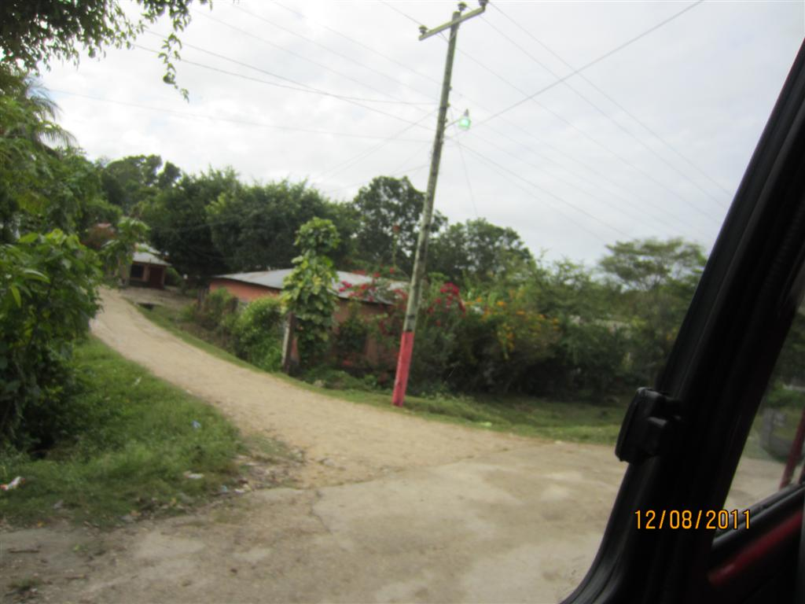

Slide 24
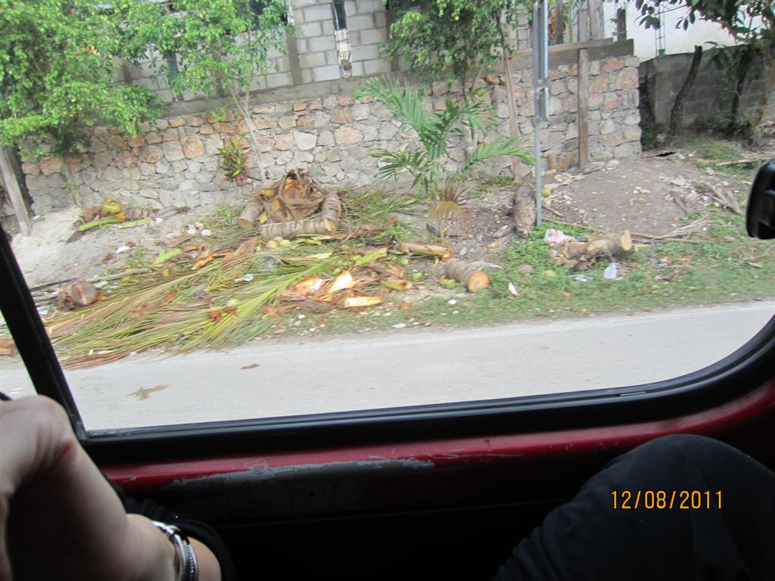

Slide 25
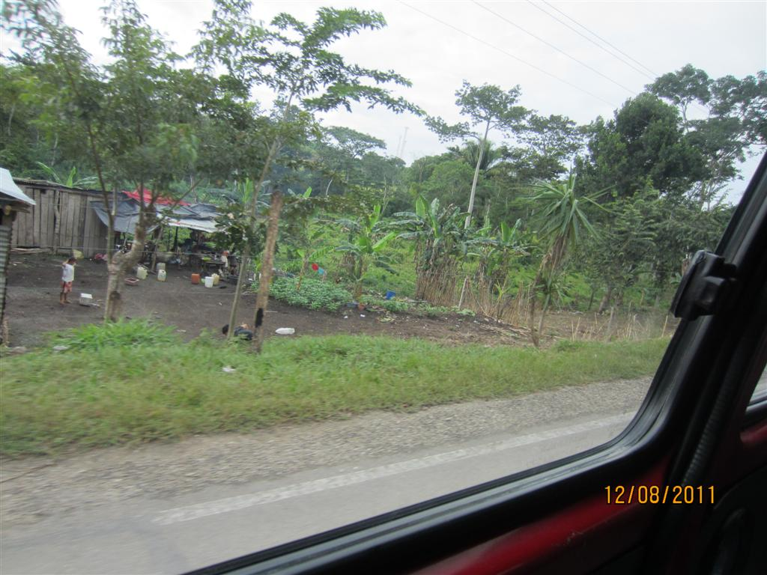

Slide 26
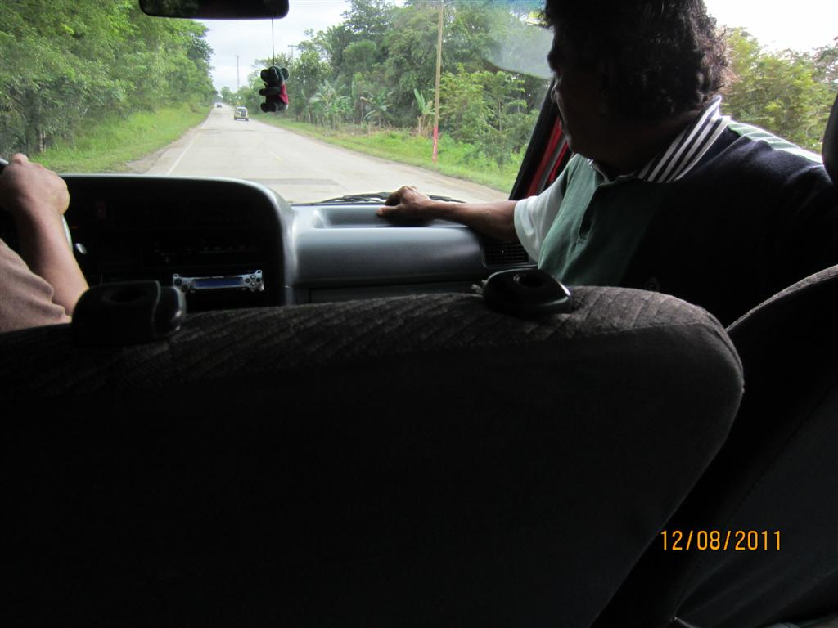

Slide 27
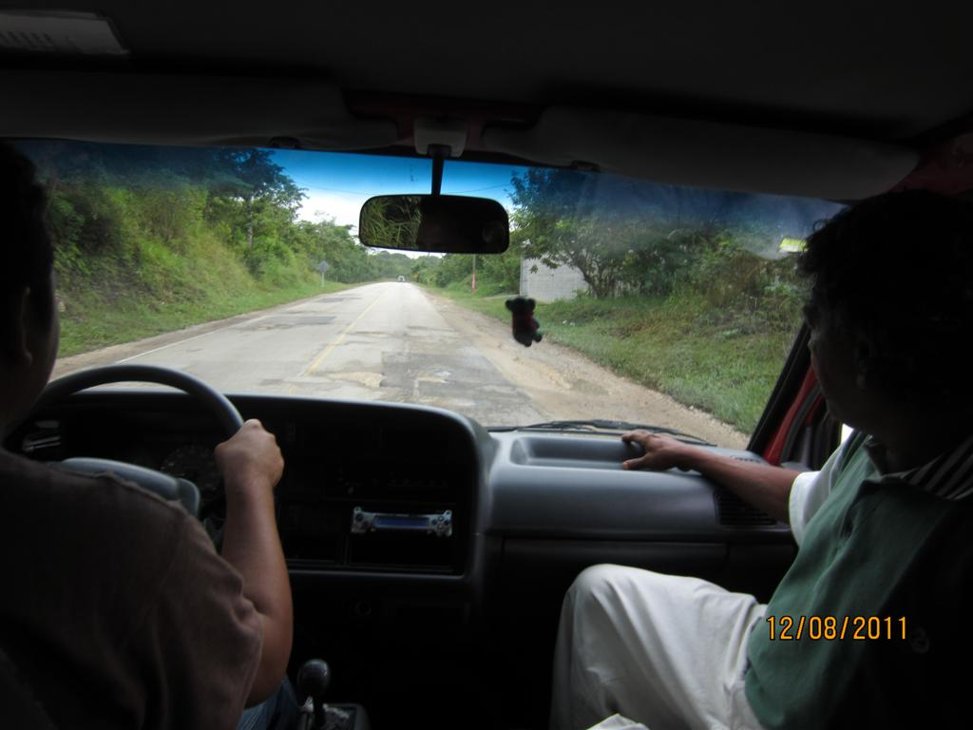

Slide 28
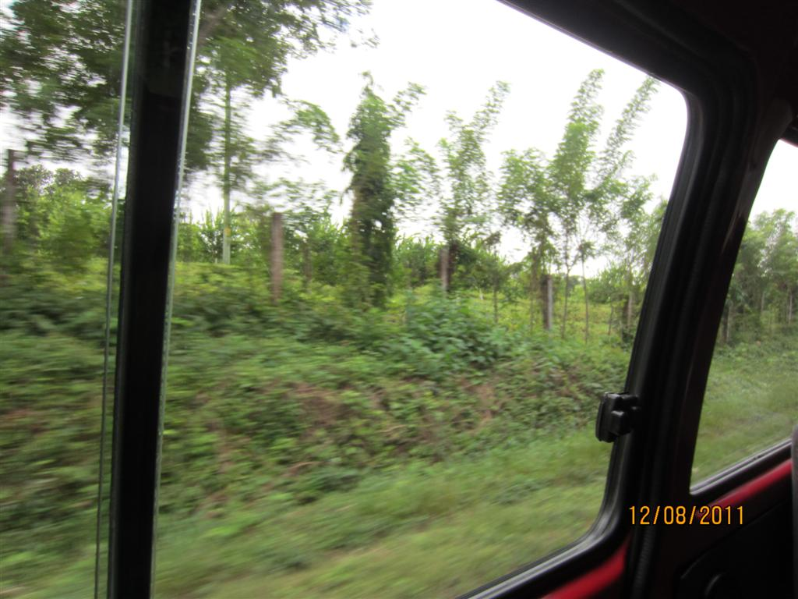

Slide 29
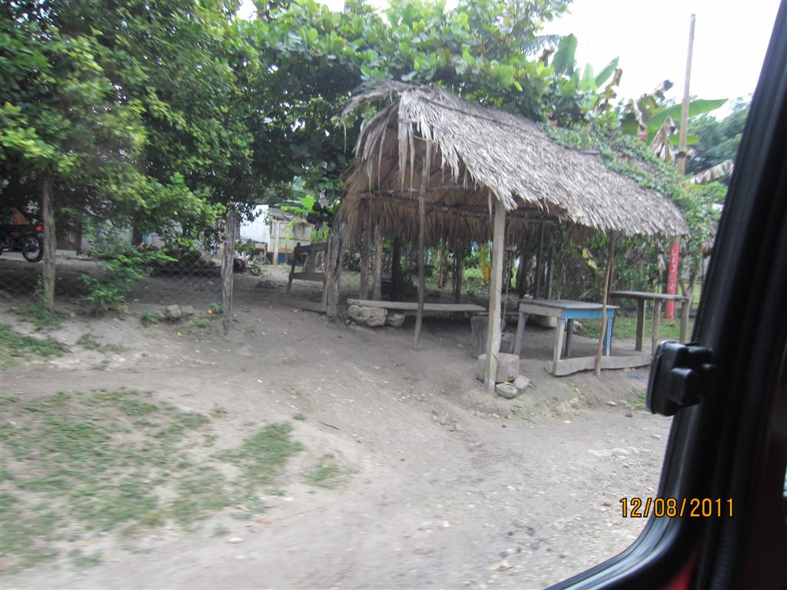

Slide 30
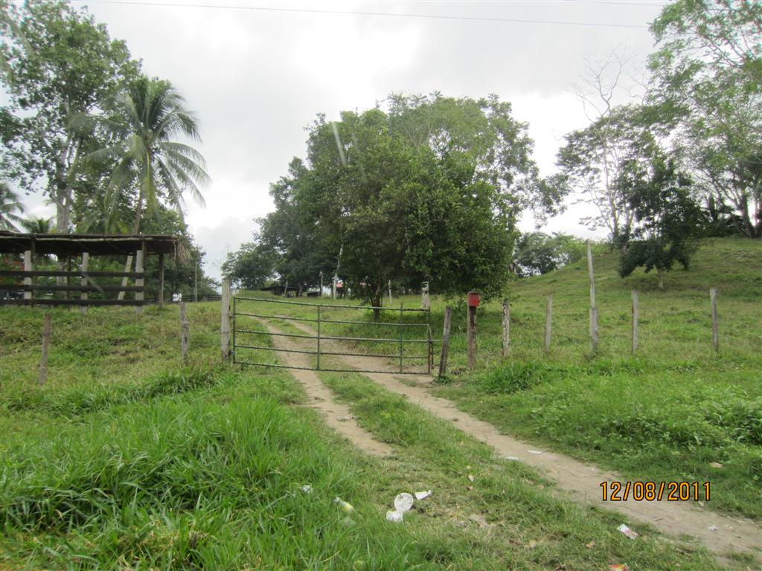

Slide 31
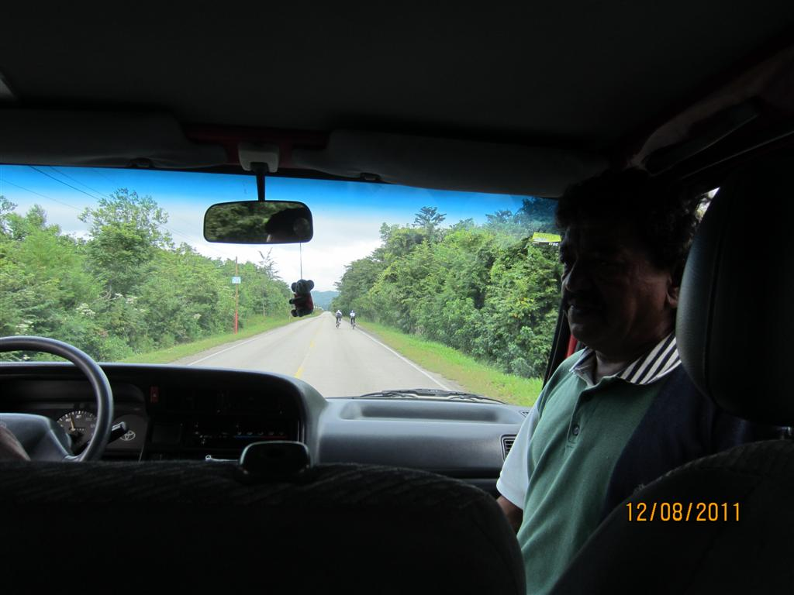

Slide 32
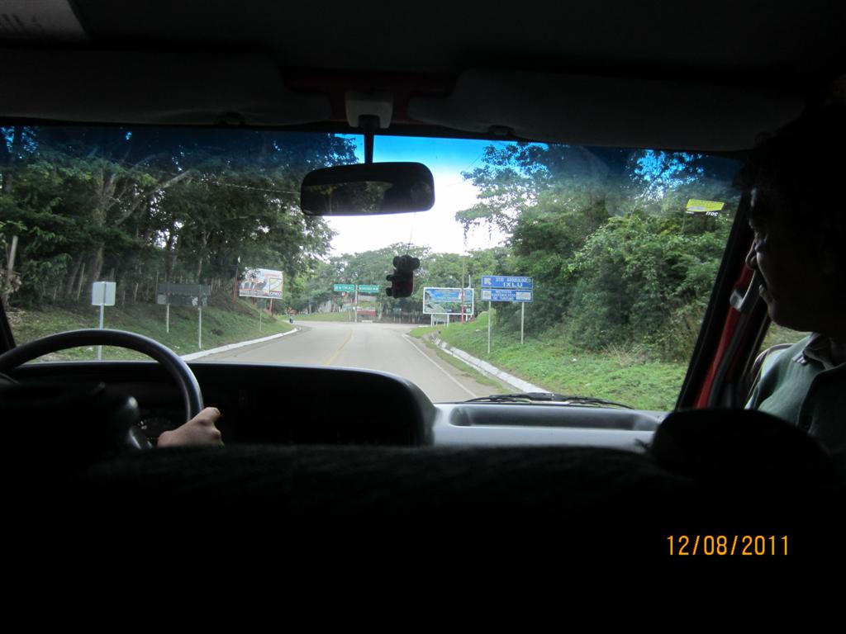

Slide 33
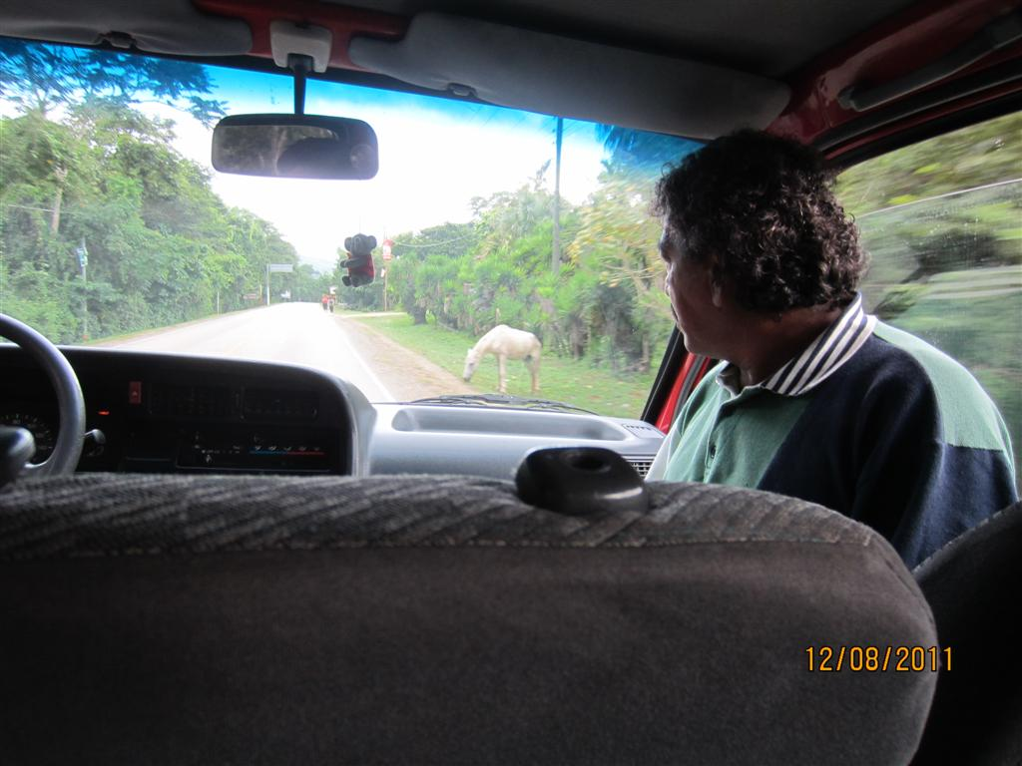

Slide 34
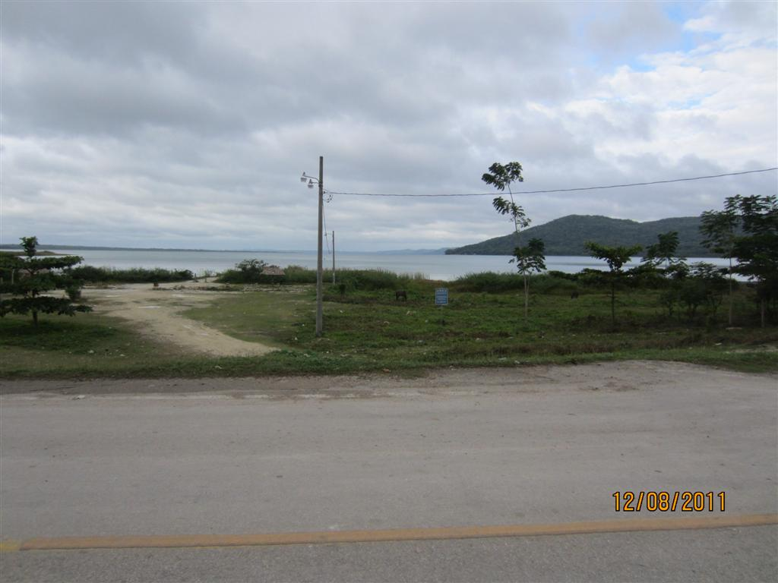

Slide 35
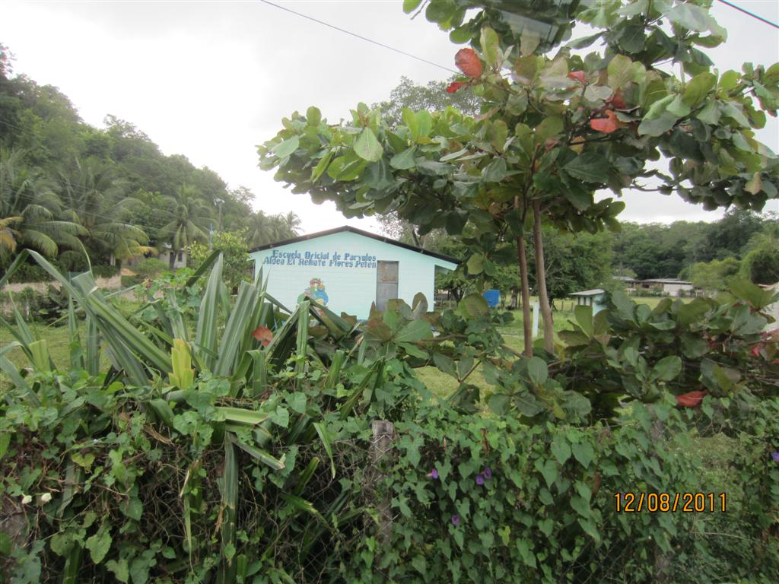

Slide 36
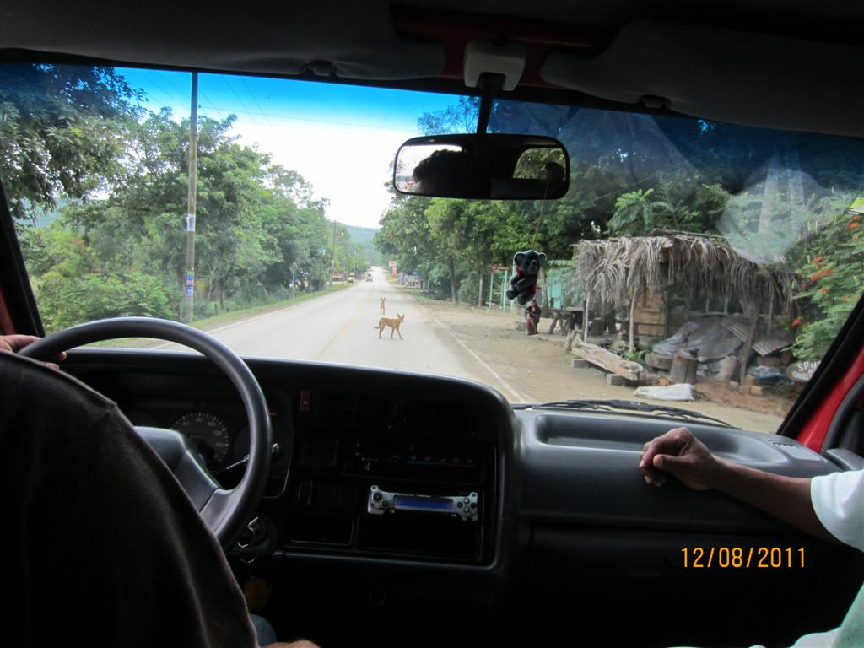

Slide 37
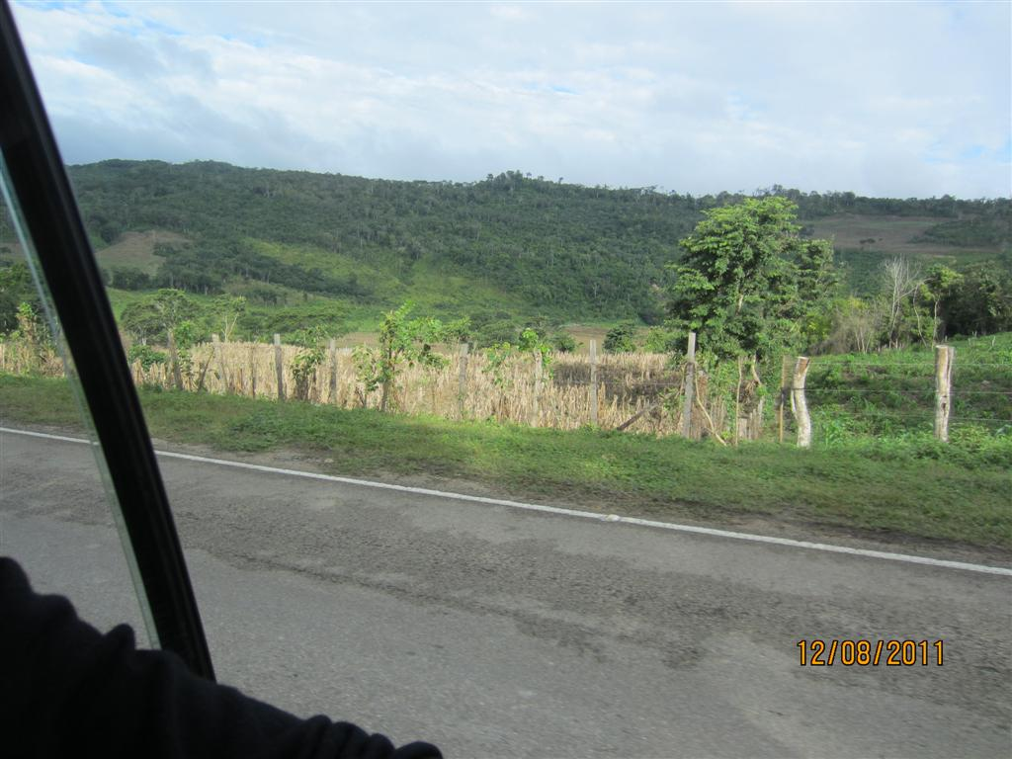

Slide 38
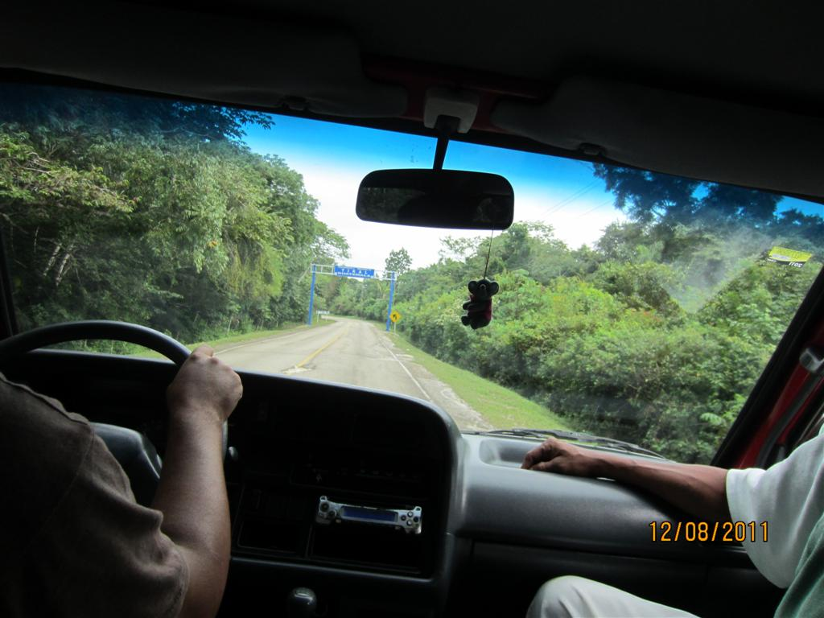

Slide 39
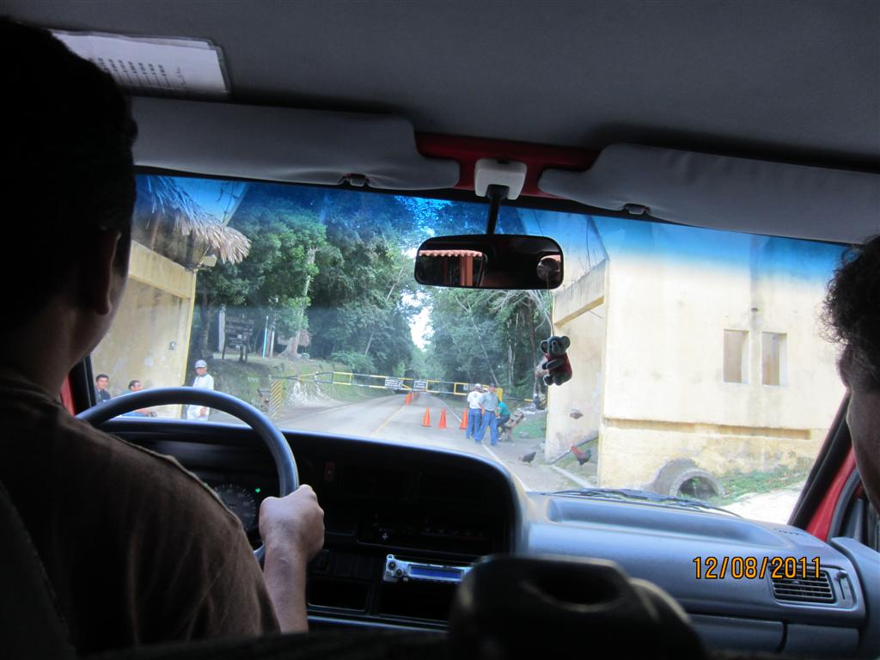

Slide 40
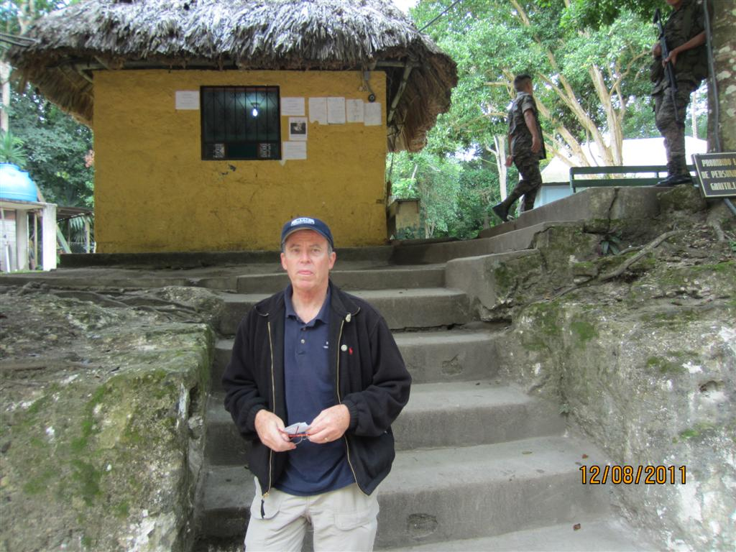

Slide 41
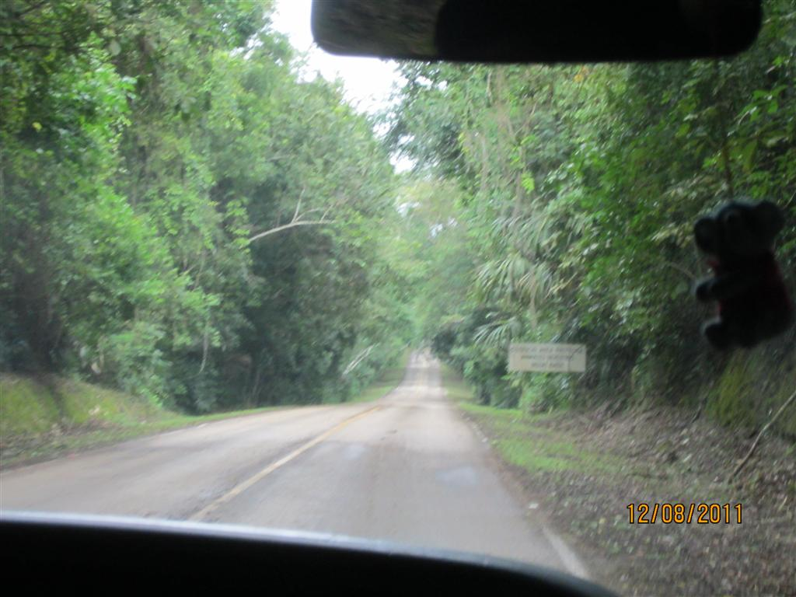

Slide 42
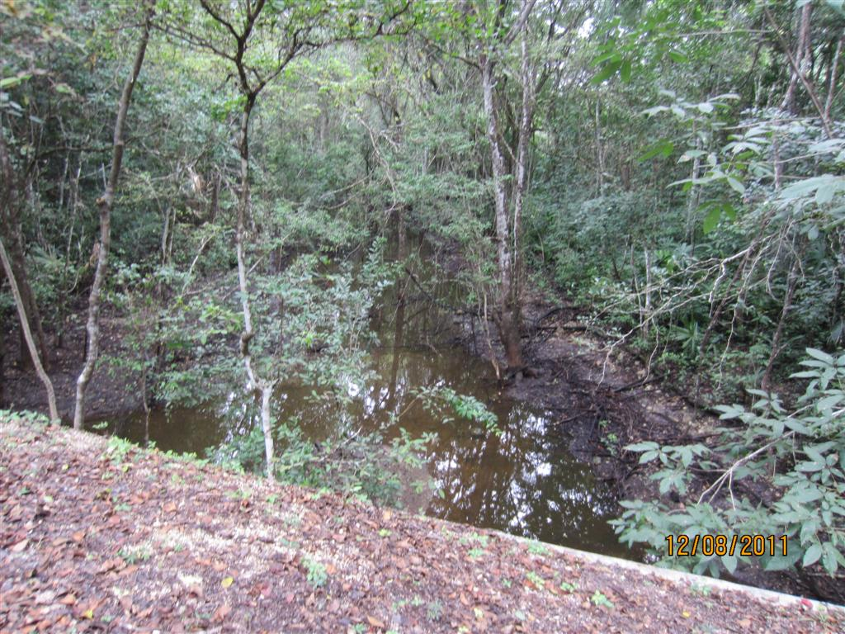

Slide 43
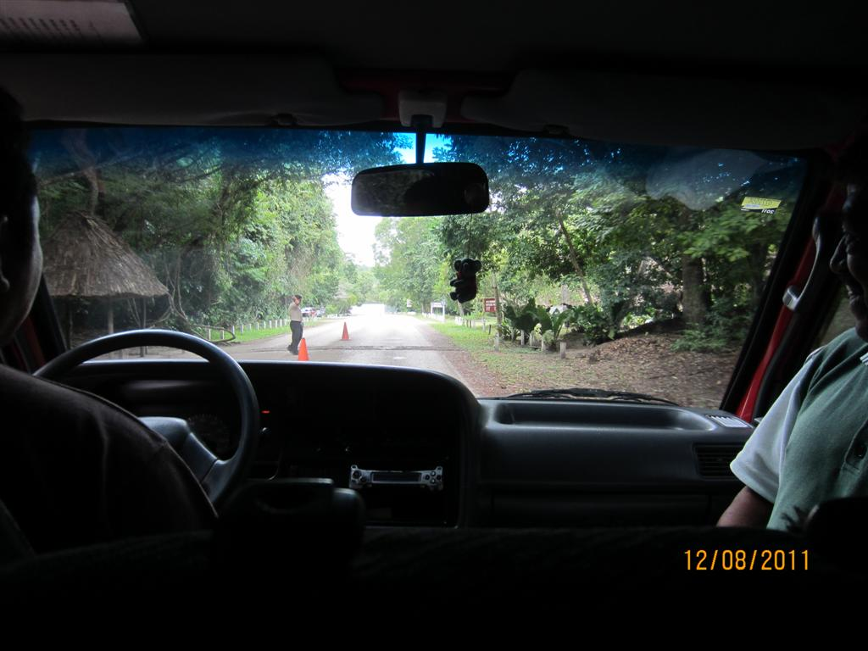

Slide 44
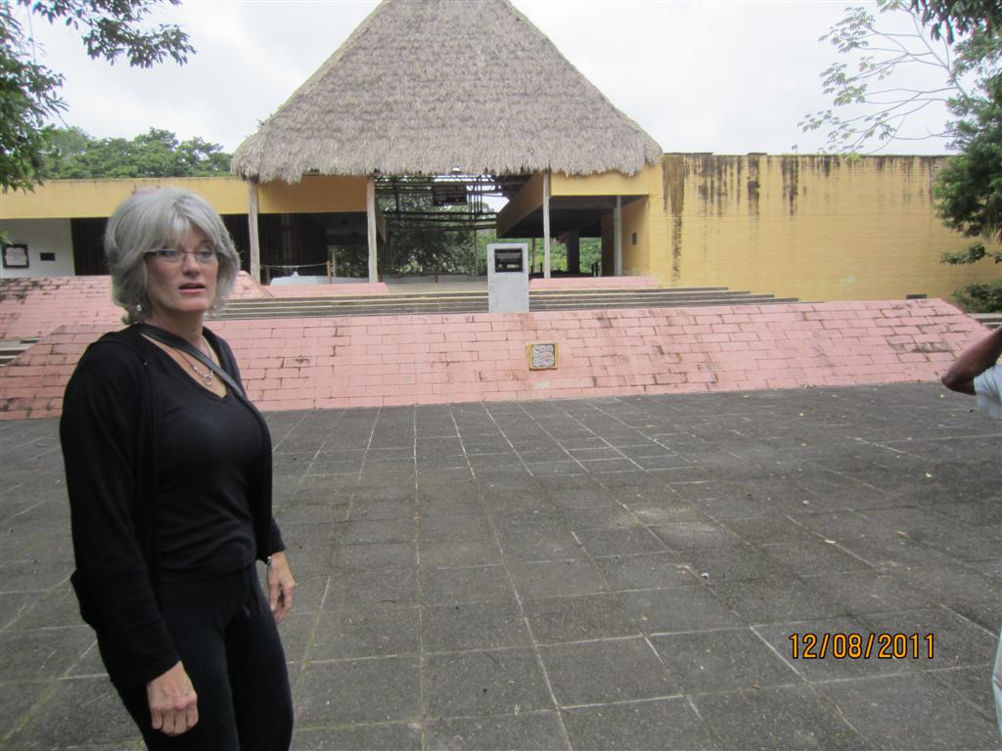

Slide 45
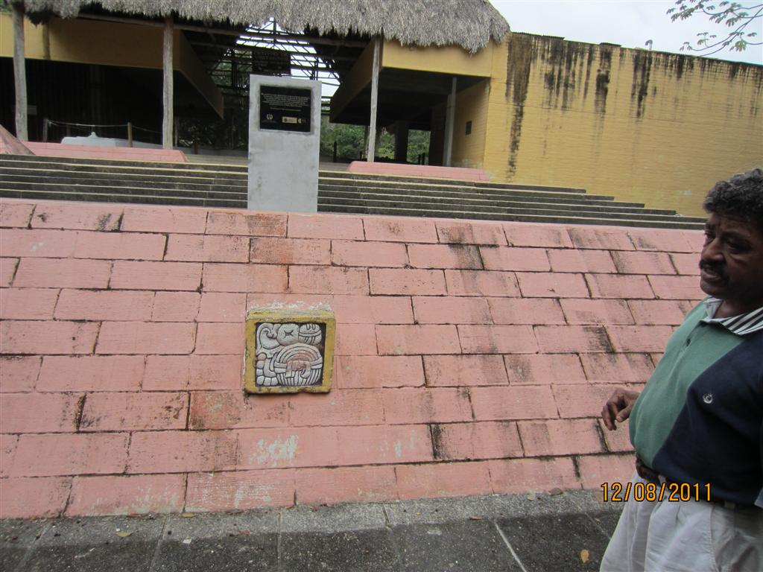

Slide 46
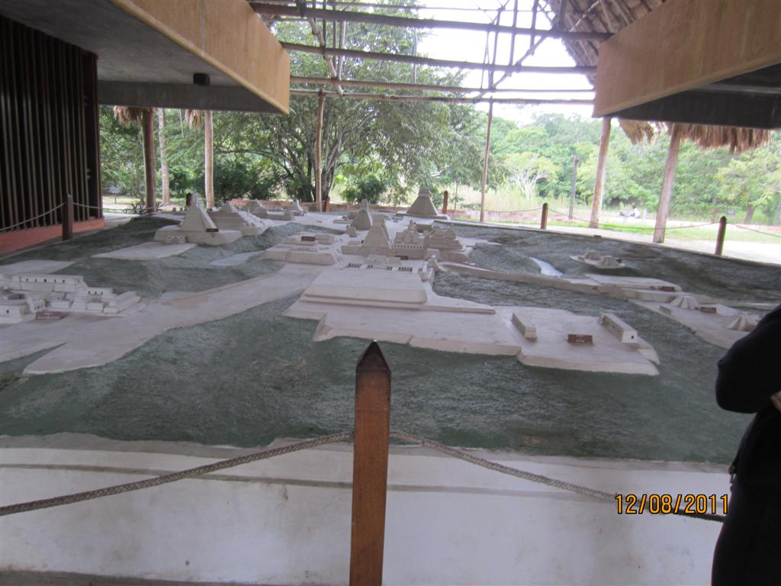

Slide 47
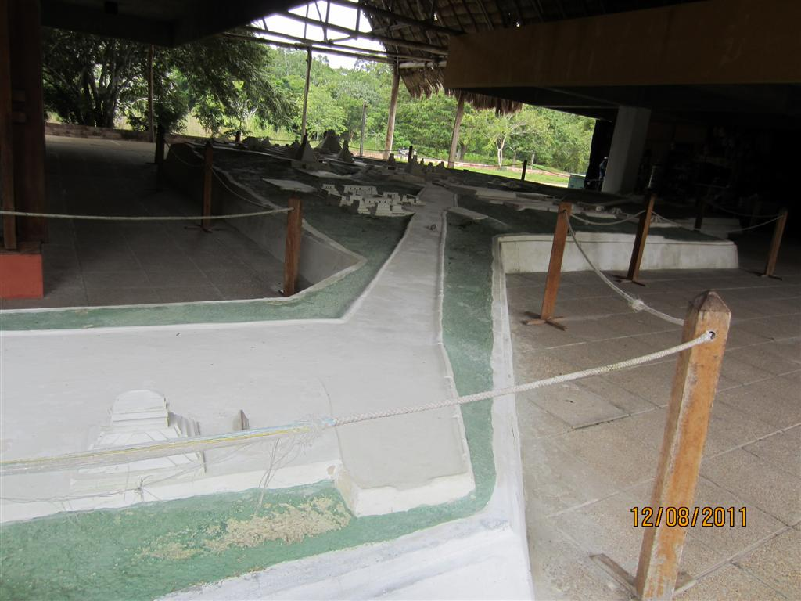

Slide 48
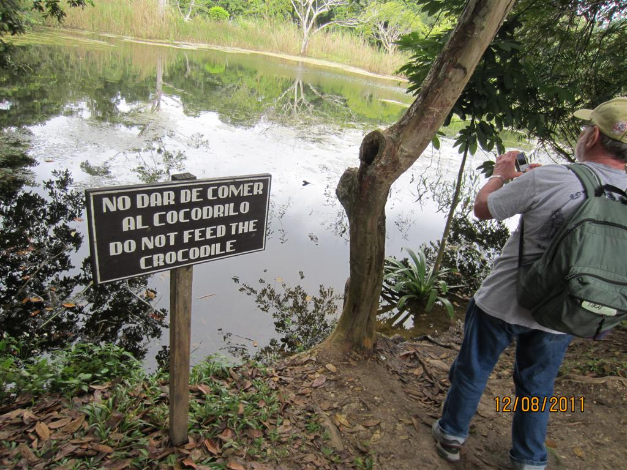

Slide 49
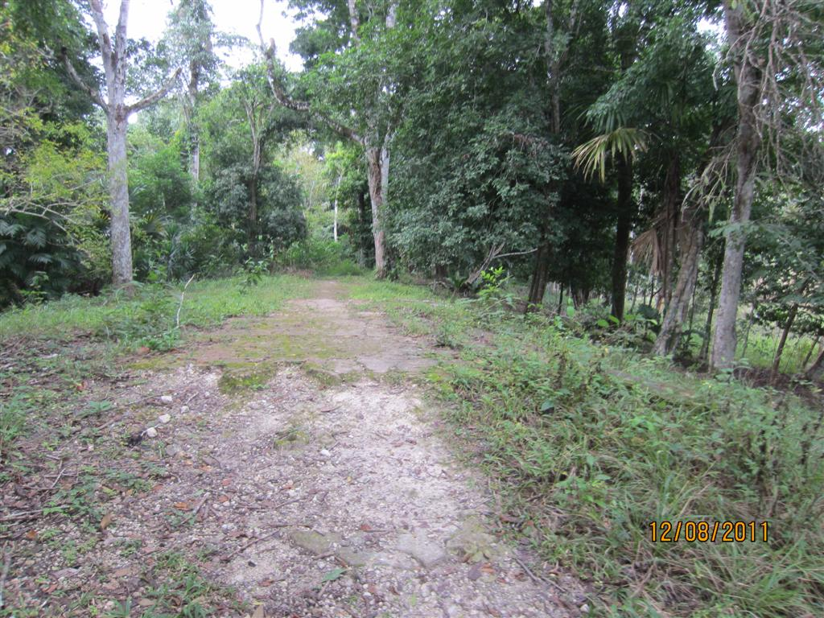

Slide 50
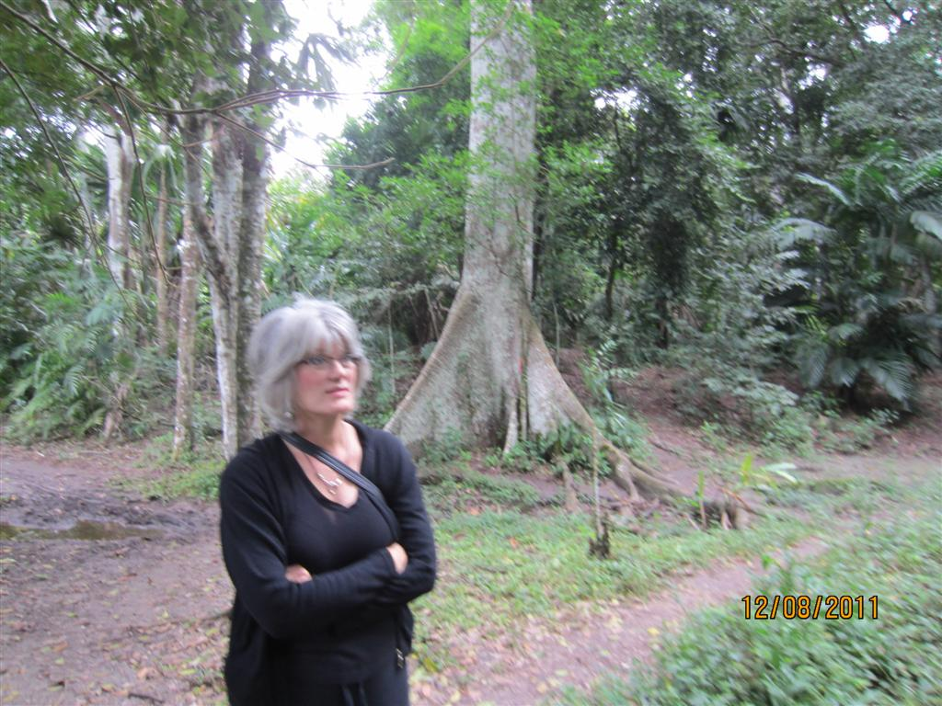

Slide 51
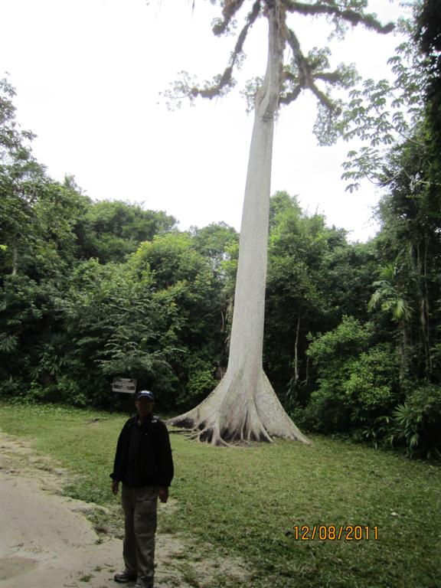

Slide 52
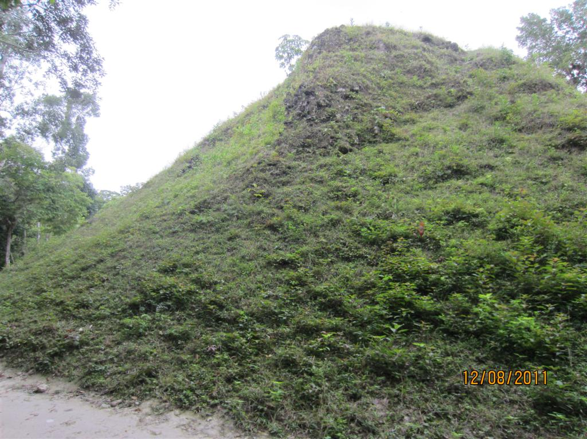

Slide 53


Slide 54


Slide 55


Slide 56


Slide 57


Slide 58


Slide 59


Slide 60


Slide 61


Slide 62


Slide 63


Slide 64


Slide 65


Slide 66


Slide 67


Slide 68


Slide 69


Slide 70


Slide 71


Slide 72


Slide 73


Slide 74


Slide 75


Slide 76


Slide 77


Slide 78


Slide 79


Slide 80


Slide 81


Slide 82


Slide 83


Slide 84


Slide 85


Slide 86


Slide 87


Slide 88


Slide 89


Slide 90


Slide 91


Slide 92


Slide 93


Slide 94


Slide 95


Slide 96


Slide 97


Slide 98


Slide 99


Slide 100


Slide 101


Slide 102


Slide 103


Slide 104


Slide 105


Slide 106


Slide 107


Slide 108


Slide 109


Slide 110


Slide 111


Slide 112


Slide 113


Slide 114


Slide 115


Slide 116


Slide 117


Slide 118


Slide 119


Slide 120


Slide 121


Slide 122


Slide 123


Slide 124


Slide 125


Slide 126


Slide 127


Slide 128


Slide 129


Slide 130


Slide 131


Slide 132


Slide 133


Slide 134


Slide 135


Slide 136


Slide 137


Slide 138


Slide 139


Slide 140


Slide 141


Slide 142


Slide 143


Slide 144


Slide 145


Slide 146


Slide 147


Slide 148


Slide 149


Slide 150


Slide 151


Slide 152


Slide 153


Slide 154


Slide 155


Slide 156


Slide 157


Slide 158


Slide 159


Slide 160


Slide 161


Slide 162


Slide 163


Slide 164


Slide 165


Slide 166


Slide 167


Slide 168


Slide 169


Slide 170


Slide 171


Slide 172


Slide 173


Slide 174


Slide 175


Slide 176


Slide 177


Slide 178


Slide 179


Slide 180


Slide 181


Slide 182


Slide 183


Slide 184


Slide 185


Slide 186


Slide 187


Slide 188


Slide 189


Slide 190


Slide 191


Slide 192


Slide 193


Slide 194


Slide 195


Slide 196


Slide 197


Slide 198


Slide 199


Slide 200


Slide 201


Slide 202


Slide 203


Slide 204


Slide 205


Slide 206


Slide 207


Slide 208


Slide 209


Slide 210


Slide 211


Slide 212


Slide 213


Slide 214


Slide 215


Slide 216


Slide 217


Slide 218


Slide 219


Slide 220


Slide 221


Slide 222


Slide 223


Slide 224


Slide 225


Slide 226


Slide 227


Slide 228


Slide 229


Slide 230


Slide 231


Slide 232


Slide 233


Slide 234


Slide 235


Slide 236


Slide 237


Slide 238


Slide 239


